Slide 1
SPHM E-Charting Example in Epic Enter Patient Mobilization dependency and equipment needs in the ‘Level of Assistance’ section in EPIC
Notes:
Have done in GOD shepherd also

Slide 2
Determining & Communicating Patient SPM Needs
To determine patients’ dependency level, pick the level/category that has one or more statements that best characterize your patient’s physical and/or cognitive function.
A dependency assessment needs to be completed and documented on admission and once during a shift (either 8 or 12 hours).
A patient mobility check should be done prior to every vertical transfer.

Slide 3
Notes:
To determine patients’ dependency level, pick the level/category that has one or more statements that best characterize your patient’s physical and/or cognitive function.
A dependency assessment needs to be completed and documented on admission and once during a shift (either 8 or 12 hours).
A patient mobility check should be done prior to every vertical transfer.

Slide 5
All other needs in Nursing Notes/Comments section e.g. Use of a flat sling with a C – Collar; Ortho/spine patients (especially those with TLSO braces); Patients in traction; Pelvic fractures
Notes:
Is this done well……..issues with all charting not just SPHM

Slide 6
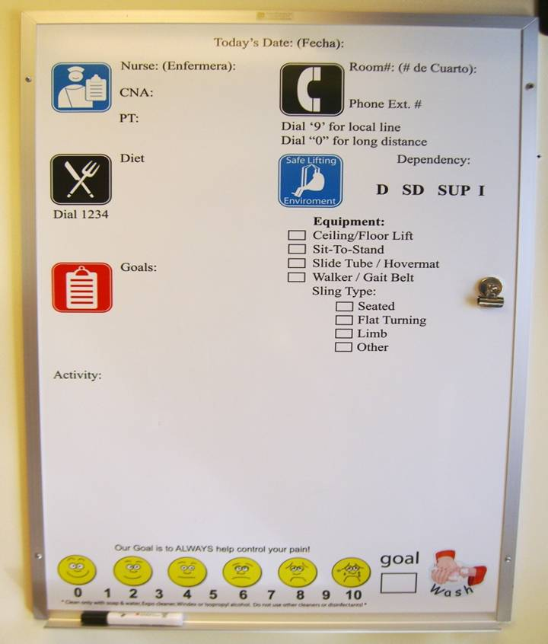
6
6
Using Staff Designed White Boards to Improve Communication
Notes:
6
6
Color coding
No sligns size why
Magnetic
How staf nursing PT
8x11 ifcant change

Slide 7
8”x11” laminated sheet in each patient room or treatment area

