Slide 1
Potentially Preventable readmissions policy
Washington State Health Care Authority
April 28, 2016

Slide 2
Agenda
Introductions (5 min)
Review Development and Status of Current (CY2016) PPR Policy (20 min)
Feedback and Q&A on PPR Reports and Claims Extracts (30 min)
Review of SFY2015 PPR Experience (15 min)
Next Steps (10 min)

Slide 3
Current (CY 2016) PPR Policy
Current PPR Policy Timeline
SFY 2014 experience used as benchmark for CY 2016 PPR rate reductions:
SFY 2014
SFY 2015
CY 2016
Establish PPR Benchmark
Use SFY 2014 Medicaid inpatient FFS claims and MCO encounter data to establish PPR benchmarks for target readmissions
Apply PPR Reductions
HCA applies prospective CY 2016 Readmission Reduction Factors based on SFY 2014 PPR benchmarks

Slide 4
CY 2016 PPR Policy Exclusions and Hospital Benchmark Rate Adjustments
Excluded newborn jaundice cases from performance measurement
Excluded ISS trauma cases from performance measurement
Excluded claims with transplant DRG and any subsequent claims within 180 days of the transplant
Excluded mental health and substance abuse claims based on APR-DRG assignment
Applied service-level adjustments (in addition to DRG risk adjustment) as follows:
Age adjustment for pediatric vs. adult patients
Secondary mental health diagnosis adjustment
Applied a statewide adjustment factor of 85 percent, reflecting an expectation of reducing WA PPR rate from 4.4% to 3.75%

Slide 5
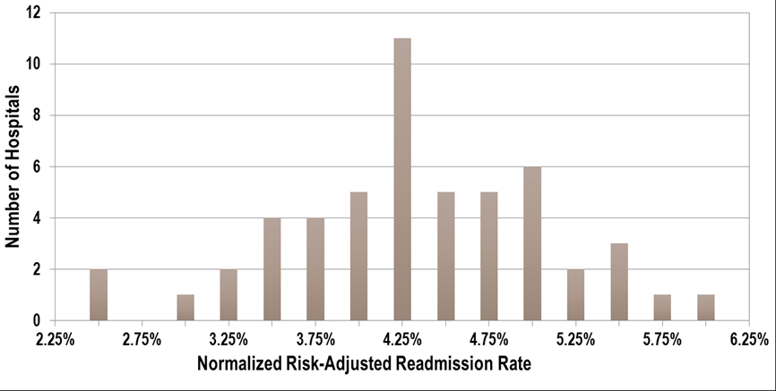
Current (CY 2016) PPR Policy
SFY2014 Normalized Risk‐Adjusted Readmission Rate Distribution Excluding hospitals with less than 10 target PPR chains
3.75% SFY2014 Statewide Benchmark Readmission Rate
4.4% SFY2014 Statewide Average Readmission Rate

Slide 6
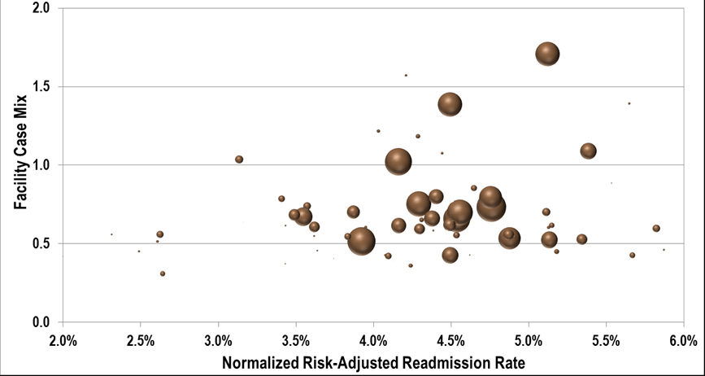
Current (CY 2016) PPR Policy
SFY2014 Normalized Risk‐Adjusted Readmission Rate and Provider Case Mix
3.75% SFY2014 Statewide Benchmark Readmission Rate
4.4% SFY2014 Statewide Average Readmission Rate

Slide 7
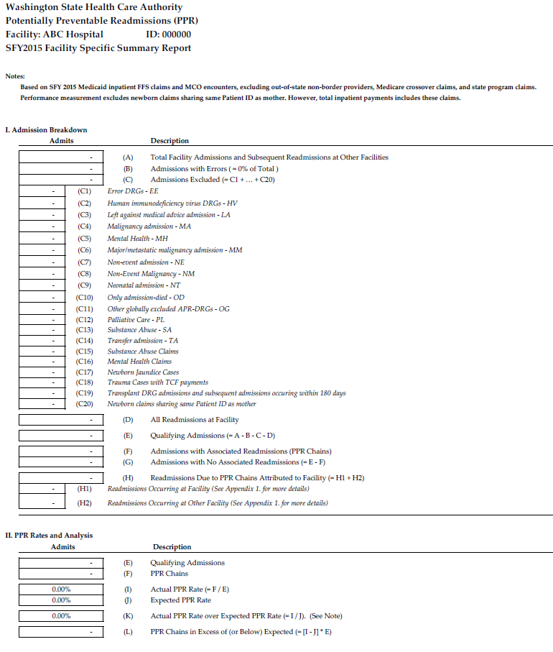
Hospital-Specific Reports

Slide 8
Hospital-Specific Claims Extracts
Claims extracts provide patient- and claim-level detail for each hospital’s PPR results
Claims extracts distributed to each hospital for the CY 2016 PPR Policy include claim-level data with the following data elements:
Reported Field from ProviderOne
Clm_Header_ID
PPR Grouper Output
PPROutput_APR_DRG
PPR Performance Measurement
Claim_MedicareID
TCN
Plan
Drvd_National_Prvdr_Idntfr
Mbr_Idntfr
Primary_Diagnosis
Patient_Status_Lkpcd
Patient_Birth_Date
From_Srvc_Date
To_Srvc_Date
Allowed_Amt
Chain_MedicareID
Chain_APRDRG
Chain_APRDRG_Desc
Chain_Age_Group
Chain_Service_Line
Claim_Substance_Abuse_Flag
Claim_Mental_Health_Flag
Chain_Jaundice_Flag
Chain_Trauma_ISS_Flag
Chain_Transplant_DRG_Flag
Claim_Final_Record_type
Claim_In_Performance_Measurement
PPROutput_APR_DRG_Desc
PPROutput_MenHeaStatus
PPROutput_Clinical_Relationship
PPROutput_Record_Type
PPROutput_Chain_Number
PPROutput_PositioninChain
Primary_Diagnosis_Desc

Slide 9
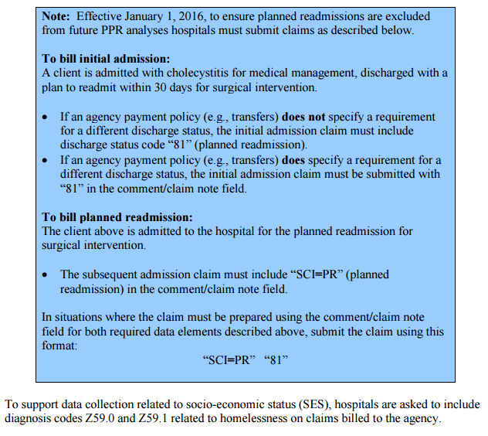
Billing Instructions for Planned Readmissions and Homelessness

Slide 10
Quarterly Informational Ppr analysis using SFY 2015 data
SFY 2015 PPR Analysis
Updated using SFY 2015 FFS claims and MCO encounters, including claims and encounters denied based on legacy readmissions policy
SFY 2015 denied encounters have been collected directly from MCO plans; SFY 2014 denied encounters were collected from Milliman encounter claims database
SFY 2015 analysis uses same methodology and parameters as the SFY 2014 analysis
SFY 2015 PPR analysis is for measurement and review purposes only and will not be used to calculate PPR rates in CY2016

Slide 11
Quarterly Informational Ppr analysis using SFY 2015 data
New SFY 2015 PPR Analysis Claim Discharge Dates
SFY 2014
SFY 2015
SFY 2016
Claims included in Readmission Model Dataset
Initial Admissions (IA)
Only Admissions(OA)
Potentially Preventable Readmissions (PPR)
Potentially Preventable Readmissions (PPR) with Initial Admissions in SFY 2015
None
Claims included in determination of Excess Readmissions
Initial Admissions (IA)
Only Admissions (OA)
None
None
Potentially Preventable Readmission (PPR): An inpatient hospital admission occurring within 30 days of a prior inpatient hospital discharge identified by the 3M PPR software as being potentially preventable.
Initial Admission (IA): An inpatient hospital admission that is not a Potentially Preventable Readmission which results in a subsequent, associated Potentially Preventable Readmission.
Only Admission (OA): An inpatient hospital admission that is not a Potentially Preventable Readmission which does not result in a subsequent, associated Potentially Preventable Readmission.

Slide 12
Quarterly Informational Ppr analysis using SFY 2015 data
SFY2015 Normalized Risk‐Adjusted Readmission Rate Distribution Excluding hospitals with less than 10 target PPR chains
4.28% SFY2015 Statewide Average Readmission Rate
3.75% SFY2014 Statewide Benchmark Readmission Rate
4.4% SFY2014 Statewide Average Readmission Rate

Slide 13
Updated Ppr analysis using SFY 2015 data
SFY2015 Normalized Risk‐Adjusted Readmission Rate and Provider Case Mix
4.28% SFY2015 Statewide Average Readmission Rate
3.75% SFY2014 Statewide Benchmark Readmission Rate
4.4% SFY2014 Statewide Average Readmission Rate

Slide 14
Updated Ppr analysis using SFY 2015 data
SFY14 vs. SFY15 Normalized Risk‐Adjusted Readmission Rate and Provider Case Mix
SFY 14 Actual Rate = 4.4%
SFY 14 Benchmark Rate = 3.75%
SFY 15 Actual Rate = 4.28%

Slide 15
Quarterly Informational Ppr analysis using SFY 2015 data
PPR Readmissions Comparison – Year By Year
SFY 2015 PPR analysis dataset shows a 22% increase in total admissions, readmission chains, and individual readmissions, as compared to the SFY 2014 analysis dataset
SFY 2015 data also shows a 55% increase in estimated denied payments under legacy readmissions policy, as compared to SFY 2014 (in part, due to improved capture of denied encounter claims)
Statewide Readmissions | SFY 2014 | SFY 2015 | Change | % Change
Total Number of Admissions Included in PPR Analysis Dataset | 134,095 | 162,974 | 28,879 | 22%
Number of Readmission (PPR) Chains | 3,786 | 4,622 | 836 | 22%
Number of Individual Readmissions (PPRs) | 4,983 | 6,058 | 1,075 | 22%
Expenditures on Readmissions (PPRs) | $53,644,923 | $63,701,922 | $10,056,999 | 19%
Estimated Denied Payments under Legacy Readmissions Policy | $6,752,321 | $10,471,317 | $3,718,996 | 55%

Slide 16
Quarterly Informational Ppr analysis using SFY 2015 data
PPR Readmission Rates Comparison – Year By Year
SFY 2015 Actual Readmissions decreased by 0.12% from SFY 2014 to SFY 2015
Statewide Readmissions Rate | SFY 2014 | SFY 2015 | Change
Actual Statewide Raw Readmission Rate | 4.40% | 4.28% | -0.12%

Slide 17
Next Steps
HCA will soon distribute first quarterly PPR reports and claims extracts, based on July 1, 2014 – June 30, 2015 (SFY 2015) experience
Second quarterly PPR reports and claims extracts will be based on January 1, 2015 – December 31, 2015 experience
Third quarterly PPR reports and claims extracts will be based on April 1, 2015 – March 31, 2016 experience
Fourth quarterly PPR reports and claims extracts and Calendar Year 2017 payment adjustments will be based on July 1, 2015 – June 30, 2016 (SFY 2016) experience

