Slide 1
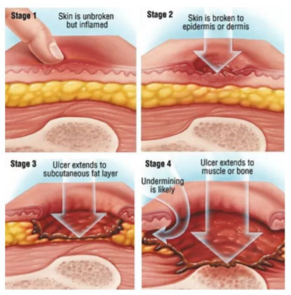

Hospital Acquired Pressure Injury Education Module Presented by Washington State Hospital Association
The information contained in this report is protected under the terms of the Washington State Hospital Association’s Coordinated Quality Improvement Program or “CQIP” as recognized by the Washington State Department of Health. Individuals and organizations contributing to the data contained in the report or viewing the report must have a signed confidentiality agreement with the Washington State Hospital Association agreeing to follow the terms of the CQIP process and they must maintain confidentiality of the information and documents shared pursuant to RCW 43.70.510, 70.41.200 and 4.24.250.

Slide 2

Amy Anderson
Director Safety and Quality
MN, BSN, CNS
amya@wsha.org
Tina Seery
Senior Director Safety and Quality
MHA RN CPHQ CPPS LSSBB
tinas@wsha.org

Slide 3
Objectives:
Understand recent data trends
Identify vulnerable populations as it relates to pressure injuries
Describe the importance of early recognition with a complete skin assessment
Recognize devices that may increase patient risk for pressure injuries

Slide 4
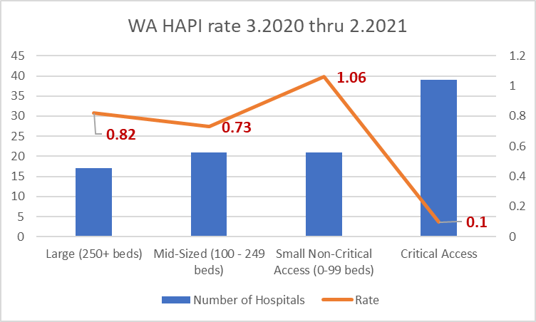
Data:
https://insights.wsha.org/#/views/QualityReport/QualityDashboard?:iid=1

Slide 5

Data:
Dec. 2019-Nov. 2020 all hospital average: 0.53
Mar. 2020-Feb. 2021 all hospital average: 0.81
This is a 52.8% increase in reported HAPI
https://insights.wsha.org/#/views/QualityReport/QualityDashboard?:iid=1

Slide 6
Best Practices to Incorporate Into Your Facility
Recognize
Recognize vulnerable populations and intrinsic/extrinsic risk factors
Utilize
Utilize evidence-based Implementation Strategies to prevent/manage skin
Create
Create Standard Workflows for your Teams
(ex. Skin assessment, care planning)
Initiate
Initiate quality review process for HAPI incidence within facility
Evaluate if comprehensive skin assessment was done
Ensure assessment and treatment orders are current
Evaluate
Evaluate your facility incidence and prevalence rates
Identify
Identify community and population risks
(i.e., Emergency Department, OR, transfer from SNF)

Slide 7
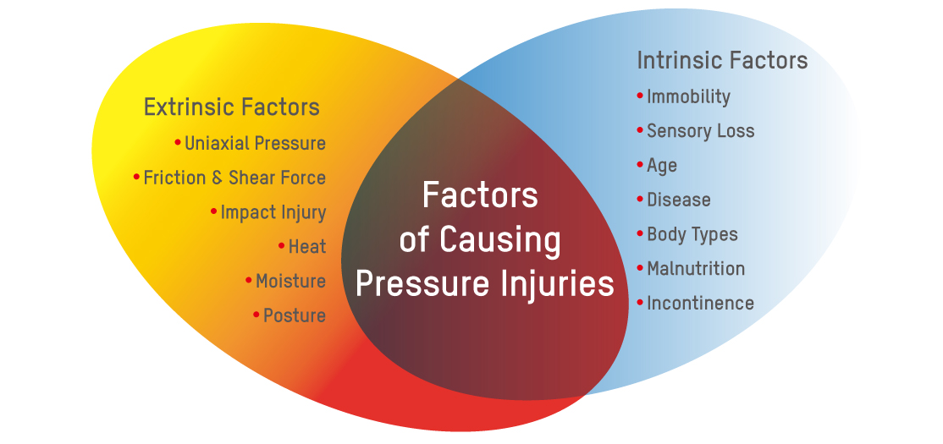
Risk factors to consider:

Slide 8
Risk factors to consider:
Intrinsic
General Health (i.e., hx of DM which ↑ risk of PI)
Mobility of patient (any decreased mobility impacting ability to move vulnerable tissues)
Nutrition status (may have multiple effects such as impaired tissue healing or ↑ risk to breakdown)
Skin Moisture
Age
History of previous PI (scar tissue may only be up to 80% as strong as original tissue)
History of drug use (ex. Steroids may impact tissue integrity)
Vascular perfusion status

Slide 9
Risk factors to consider:
Extrinsic
Pressure
Force applied perpendicular to tissue
Tend to be uniform or circular in shape; neat appearance
Shear
Action or stress which causes two contiguous internal parts of the body to deform in the transverse plane
Tend to cause deeper tissue damage, may not be immediately visible; skin edges may also be ragged
Friction
Contact force parallel to the skin surface in case of sliding (sliding surfaces along each other)
Often presents as a shallow, stripped and painful area; characterized by messy wounds with ragged edges
Skin Microclimate
Local tissue temperature and moisture at the body/support surface interface
Moisture is known to impact the ability of the skin to function

Slide 10
Other vulnerable populations:
BP BELOW 100/55
HCT BELOW 30 (HGB BELOW 10)
SHOCK: SEPTIC, NEUROGENIC, CARDIAC
DIALYSIS
PROJECTED MULTIPLE SURGERIES
SPINAL CORD INJURY/SPINA BIFIDA
STROKE OR NEUROLOGICAL DISORDER
ANYONE ON SURFACES >2 HOURS (I.E. EMERGENCY ROOM, SURGICAL SERVICES, DIAGNOSTIC IMAGING )

Slide 11
Medical Devices Increasing Risk of Pressure Injuries:
Medical devices account for more than 30 percent of all hospital-acquired pressure injuries (Health & Education Trust, 2017)
Clinicians should assess skin under/around medical devices to identify for early signs of pressure injury
Medical devices should be re-positioned frequently in order to redistribute the force and pressure
Ensure device is proper size, in proper location and secured properly; additionally, some medical devices may require padding to reduce friction (follow manufacturers guidelines)
Documentation and communication: use standardized forms, tools and technologies to assist clinicians in documentation and communication amongst each other

Slide 12
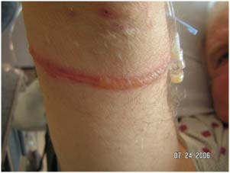
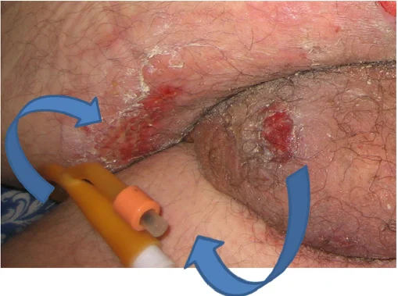
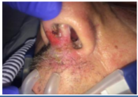
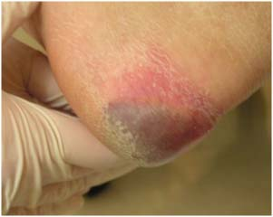
Medical Devices and Pressure Injuries
Examples of medical devices that cause pressure injuries in patients:
IV sites and tubing (pic A)
Urinary catheters (pic B)
ET/NG tubes
Oxygen tubing or O₂ saturation probe (pic C)
TENS units
Compression devices (pic D)
Restraints/splints
CPAP mask
A
B
C
D

Slide 13

Importance of Early Recognition and Teamwork
Prevention requires a coordinated effort among multiple disciplines to develop and implement the patient’s care plan.
High quality prevention requires a system culture and operational practices that support teamwork and communication

Slide 14
Importance of early recognition and teamwork
Utilize comprehensive skin assessment and risk assessment from the Braden to build an individualized plan of care for patient
RN scope of practice is to assess and document findings of comprehensive skin assessment (“4 EYES IN 4 HOURS” – this method uses 2 RNs to complete the initial skin assessment)
Note: Other care providers may be within scope of practice to perform and document a comprehensive skin assessment
CNA should examine skin each time patient is repositioned or cleaned and share results with RN
Don’t be afraid to ask for extra help from a peer!

Slide 15
Process for comprehensive standardized skin assessment:
Process
Process written into facility policy
Complete within 4 hours of admission, daily, upon transfer, if the patient condition warrants, or if the patient has been away from the unit ≥ 4 hours
Explain
Explain to the patient and family what you will be doing
Evaluate skin on entire body, talking to patient throughout assessment
Explain what you are looking for
Protect
Protect patient’s privacy during assessment
Minimize exposure of unnecessary body areas
Ask for help to turn patient if/as needed
Ensure
Ensure patient comfort
Wash
Wash hands prior to assessment
Wear gloves and change them as necessary
Consider use of flashlight or hand-held mirror if habitus warrants need of better visualization

Slide 16
Comprehensive standardized skin assessment:
  Areas to focus on:
    Skin under/around medical or compression devices
    Bony prominences (heels, sacrum, occiput)
    Areas of decreased sensation or previous skin breakdown (hx of Diabetes Mellitus, Neuropathy, etc.)
    Patient is receiving medication that decreases sensation (i.e., epidural/spinal)
    Areas where skin to skin contact is occurring (i.e., penis, back of knees, buttocks, and inner thighs)
    Areas where skin has not been repositioned in ≥ 2 hours (i.e., Emergency Department, EMS transport, Surgical services)

Slide 17
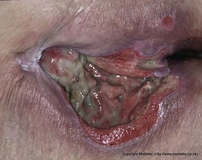
Bariatric Patient – Specific Considerations:
      Consider use of flashlight
      Skin folds and inner aspects of thighs increase risk of skin breakdown
      Increased risk for skin maceration/rash, breakdown, or infection (ex. Candidiasis)
      Evaluate extremities for lymphedema, vascular changes, increased edema
      Assess perineum for Candidiasis or Dermatitis

Slide 18
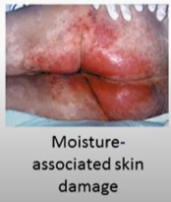
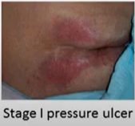
5 Parameters of a Comprehensive Skin Assessment
Temperature
Palpate patient’s skin
Skin warmth or coolness can indicate Stage I HAPI, suspected deep tissue pressure injury (DTPI), infection, pre-ulceration, etc.
Turgor (firmness)
Can you “tent” the skin?
Dehydration or elderly may have slow to return turgor; increases risk of skin tear
Moisture
Skin can be too dry (verosis) or become damaged from too much moisture (maceration)

Slide 19
5 Parameters of a Comprehensive Skin Assessment
Color
Redness can indicate rash, infection, cellulitis
Sacral redness can be from multiple causes (i.e., incontinence, perspiration, wound exudate, moisture between skin folds, ostomy leak)
Ensure correct etiology is found so that appropriate treatment can be initiated
Possible vitamin deficiencies causing blotchiness (ex. Vitamin C, Zinc)
Investigate blanchable versus non-blanchable erythema, paper-thin skin, purple or reddened skin or any bruises (*darkly pigmented skin does not blanch)
Integrity
Intact? If not intact, document why it is not intact
Possible etiologies to consider are: pressure injury, peripheral vascular (venous/arterial)issues, skin tears/trauma, neuropathic or diabetic.
Rashes? Open areas?

Slide 20

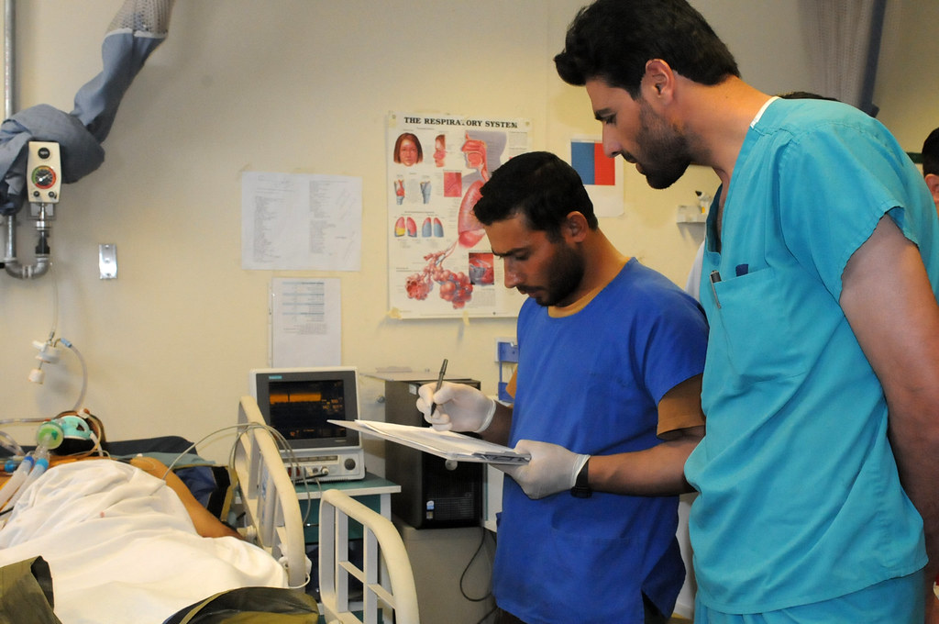
Bedside Report:
Skin
Skin assessment and Braden risk stratification are important elements of bedside handoff
Involve
Involve patient and family in conversation when possible
Report
If skin integrity problems are found, report to LIP as soon as possible

Slide 21
Documentation
Consider building within EMR to assist staff with workflow:
    “Dot” phrases for ease of documentation
    Checklists including all 5 parameters of complete skin assessment
    Diagram of body outline where staff can document skin changes that have been observed
    Ensure staff know where to find documentation fields and requirements for completion
Document all Present on Admission (POA) pressure injuries, or normal findings
    Take pictures for POA pressure injuries
    Dressings (use silicone dressing and waffle cushion for any one risk factor)
    Moisture Management
    Repositioning

Slide 22





Key Points to Remember!
HAPI rates are on the rise, but we can partner together to change this!
Prevention requires a coordinated effort among multiple disciplines to develop and implement the patient’s care plan
Utilize “4 eyes in 4 hours methodology” with 2 RN staff completing standardized comprehensive skin assessment
CNA’s visualize skin with each repositioning and communicate results with RN
Recognition of areas of patient vulnerability (i.e., medical devices, lying on surfaces ≥ 2hours, areas of decreased sensation, decreased perfusion)
Creation of individualized care plan after risk assessment
Evaluate HAPI incidences within quality review process
Identify if “4 eyes in 4 hours” was completed and documented
Evaluate if assessment and treatment orders were completed as prescribed
Use of tools to decrease patient risk (ex. Mepilex, waffle cushion, silicone dressing)

Slide 23
References:
Health Research & Educational Trust. Hospital Acquired Pressure Ulcers/Injuries (HAPU/I): April 2017. Chicago, IL: Health Research & Educational Trust.
https://www.ahrq.gov/patient-safety/settings/hospital/resource/pressureinjury/workshop/guide3.html
https://npiap.com/
https://npiap.com/page/FreeMaterials
https://npiap.com/page/2019Guideline
Kirkland-Kyhn, Teleten et al. OWM, 2017;63(2):42-47, 2017.
Kirkland-Kyhn, Teleten et al. WMP, 2019;65(2):14-19.
Pan Pacific Pressure Injury Alliance. (2019). Prevention and treatment of pressure ulcers/injuries: clinical practice guideline: the quick reference guideline 2019.
Pressure ulcer prevention: pressure, shear, friction and microclimate in context. A consensus
Preventing Pressure Ulcers in Hospitals: A Toolkit for Improving Quality of Care. (ahrq.gov)
The Joint Commission. Managing medical device-related pressure injuries. Quick Safety. Issue 43, July 2018. Oakbrook Terrace, IL: The Joint Commission
World Union of Wound Healing Societies (WUWHS). Consensus Document: Role of dressings in pressure ulcer prevention. London, UK: Wounds Int; 2016 document. London: Wounds International (2010).

