Slide 1
Washington’s 2017 Nurse Staffing Law – An Overview and Tools to Ensure Success
Nurse Staffing Coalition, September 25, 2018
Anne Tan Piazza, MBA – WSNA, Senior Director of Strategic Initiatives
Ian Corbridge, RN – WSHA , Policy Director
Jane Hopkins, RN – SEIU Healthcare 1199NW, Executive Vice President
Jennifer Graves, RN – WSHA, Senior Vice President, Patient Safety and Quality
Sally Watkins, PhD, RN – WSNA, Executive Director
Samantha Grad, UFCW 21, Political and Legislative Organizer
Stacey Opiopio, UFCW 21, Membership Action Director
Notes:
IAN

Slide 2
Welcome!
A Few Things to Keep in Mind
We will hold 10-15 minutes at the end of the presentation for Q&A
Please type question in the chat box
The webinar will be recorded and available after the meeting
Slides will be shared after the webinar via email
Notes:
IAN

Slide 3
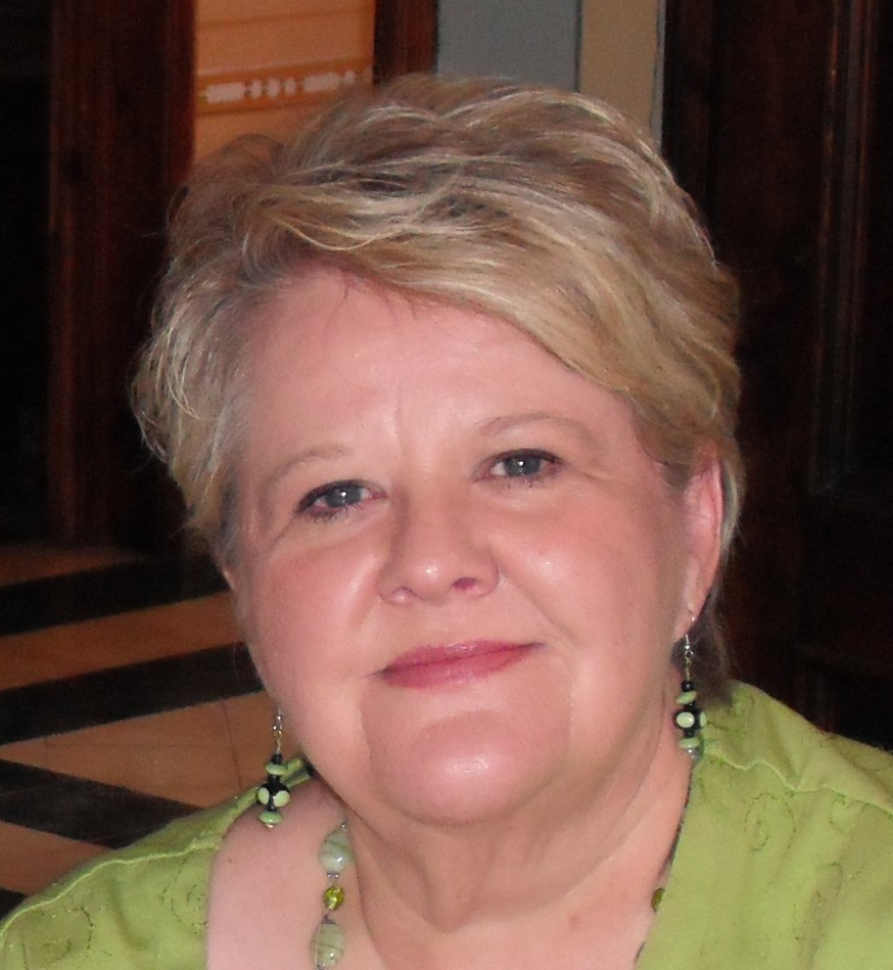
Presenters
WSNA
UFCW
SEIU
WSHA
DOH
Notes:
IAN

Slide 4
Objectives
Describe the Coalition
Review existing law
Review updates to the Washington state staffing law
Review tools developed by the collaborative effort between hospital association and union leaders
Department of Health role and process
Notes:
IAN

Slide 5
Coalition– WSNA, WSHA, SEIU 1199NW, UFCW21
Monthly meetings
Consensus-based decision making
Tools to help with implementation
Future: education, help resolve issues
Notes:
IAN
Met monthly between November 2017 through June 2018
Collaborative process - all decisions made by consensus
Developed tools to help with implementation: focused on what’s required by the law and best practices
Plan to continue working collaboratively to help identify and resolve issues

Slide 6
Existing Law
Enacted in 2008 and remains in place - RCW 70.41.420 and 70.41.425
Requires nurse staffing committees with 50/50 staff nurse and management
Committees develop unit and shift-based staffing plans based on variety of factors specified in law
Plans posted in patient care units
Semi-annual review of plans
Committee reviews staffing concerns
If the nurse staffing plan is not adopted by the hospital, the CEO must provide a written explanation to the nurse staffing committee
Notes:
CHRIS
Many hospital do not have functioning nurse staffing committees

Slide 7
2017 Patient Safety Act
House Bill 1714 updated existing law
Improves transparency and accountability of staffing plans
Clarifies nurse staffing roles and responsibilities
Strengthens staffing committees
Establishes formal complaint process
Requires the Washington State Department of Health to submit a report to the legislature by December 31, 2020.
Notes:
CHRIS
Include the number of complaints submitted, investigated, associated costs to DOH and any recommended changes to statute.
The Nurse Staffing Coalition will review the report before it is submitted to the legislature.

Slide 8
Important Dates
New considerations for developing staffing plans (effective date – July 23, 2017)
Additional changes to staffing committee process (effective date – January 1, 2019)
Staffing plans due to the Dept of Health (January 1, 2019)
Report to legislature (December 31, 2020)
Expiration date (June 1, 2023)
Notes:
CHRIS

Slide 9
New Requirements
Plans must take into account:
Hospital fiscal data
Support personnel
Meal and rest breaks
The CEO may modify the nurse staffing committee plan or come up with their own alternative plan
Hospitals must follow nurse staffing plans
Notes:
CHRIS

Slide 10
Dept of Health shall investigate failure to
Form or establish staffing committee
Conduct semi-annual review of staffing plan
Submit staffing plan and any updates to Dept of Health
If confirmed and unaddressed, can lead to financial sanctions
Notes:
CHRISTIE

Slide 11
Dept of Health may investigate staffing assignment complaints
Continued pattern for a 60-day continuous period of unresolved staffing assignment complaints
Failure to follow nurse staffing plan
RN objections to shift-to-shift adjustment to plan
Excludes unforeseeable emergency circumstances or documented reasonable efforts to obtain staffing
If confirmed and unaddressed, can lead to financial sanctions
Notes:
CHRISTIE

Slide 12
New Nurse Staffing Tools
Checklist
Nurse staffing committee charter
Nurse staffing plan minimum criteria
CEO attestation form
Assessing and evaluating complaints
Sample complaint form
Complaint tracking form
Notes:
SAMANTHA/STACEY

Slide 13
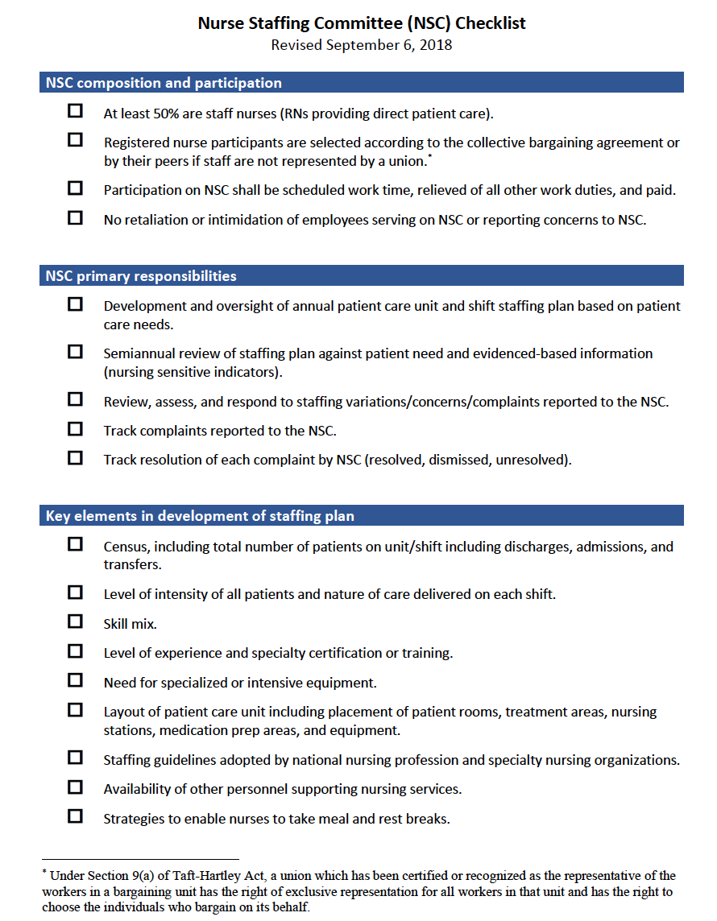
Nurse Staffing Committee Checklist
Notes:
SAMANTHA/STACEY
Checklists for:
Composition and participation
Primary responsibilities
Key elements in developing a staffing plan
Posting, disclosure, implementation, and complaints

Slide 14
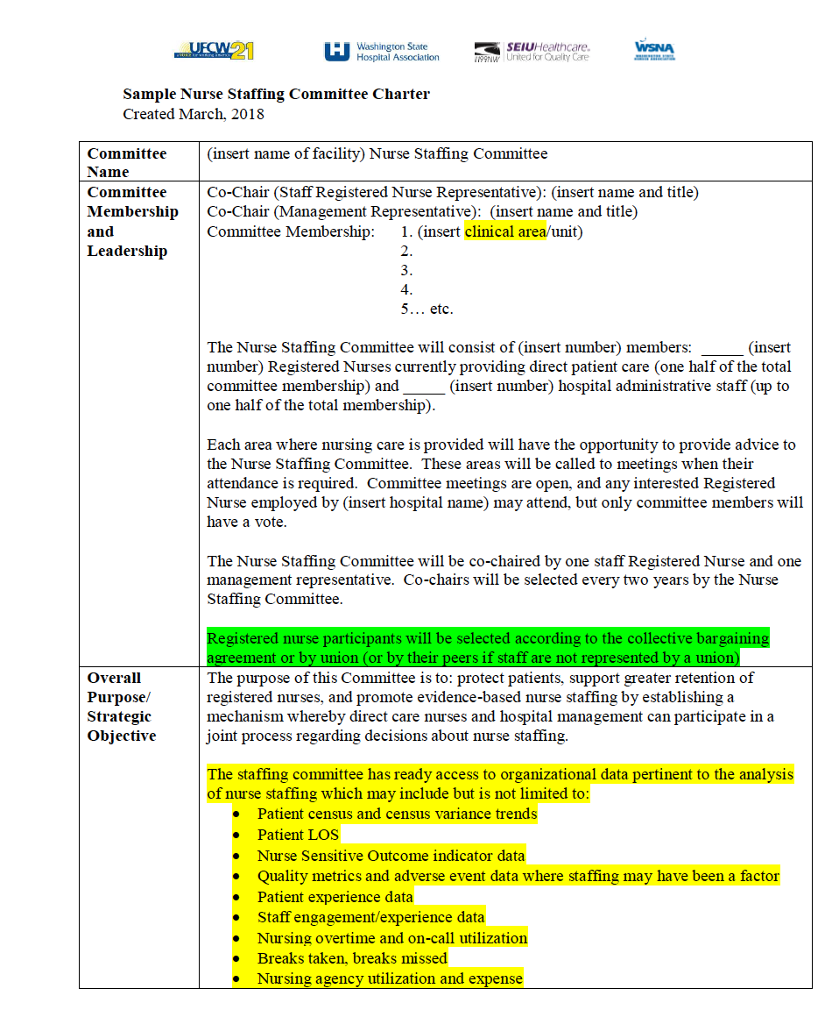
Nurse Staffing Committee Charter
Notes:
SAMANTHA/STACEY
Describes roles, responsibilities, and key processes for the nurse staffing committee including:
Membership
Purpose
Tasks
Timelines
Meeting management
Describe color coding – yellow highlights for best practices, green highlights for new requirements in 1714

Slide 15
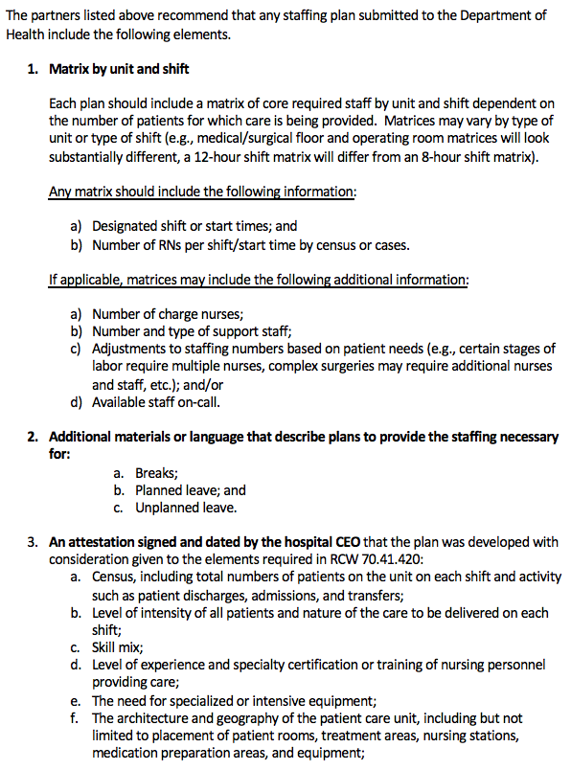
Nurse Staffing Plan Key Elements
Notes:
ANNE/SALLY
Matrix by unit and shift
How to staff breaks, planned and unplanned leave
Attestation signed by the CEO

Slide 16
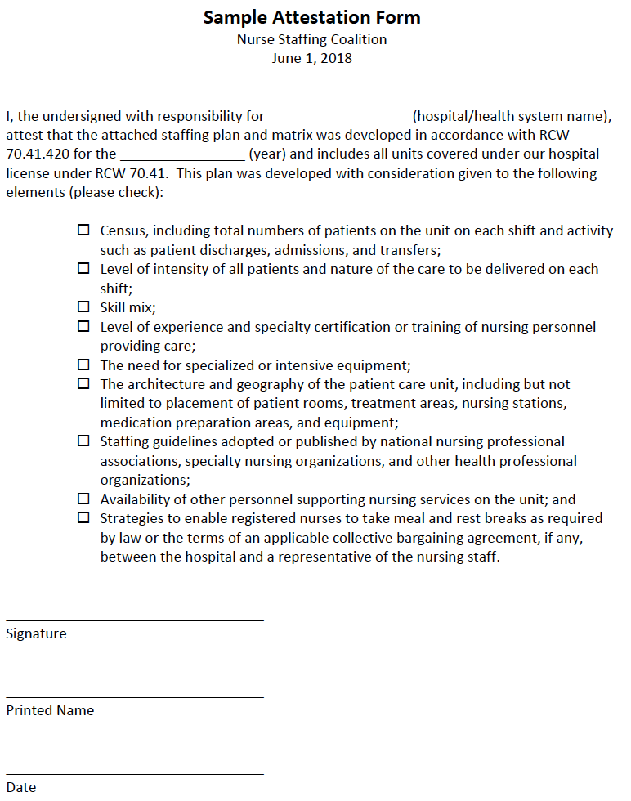
CEO Attestation Form
Notes:
ANNE/SALLY
Covers all units under hospital license
Process has included consideration of all elements required by law

Slide 17
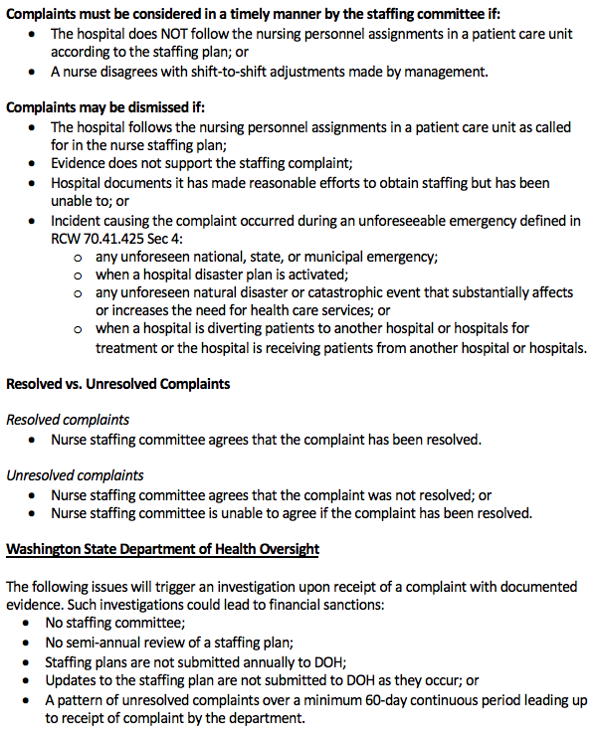
Assessing and Evaluating Complaints
Notes:
ANNE/SALLY
Guidelines for:
Dismissed complaints
Resolved complaints
Unresolved complaints

Slide 18
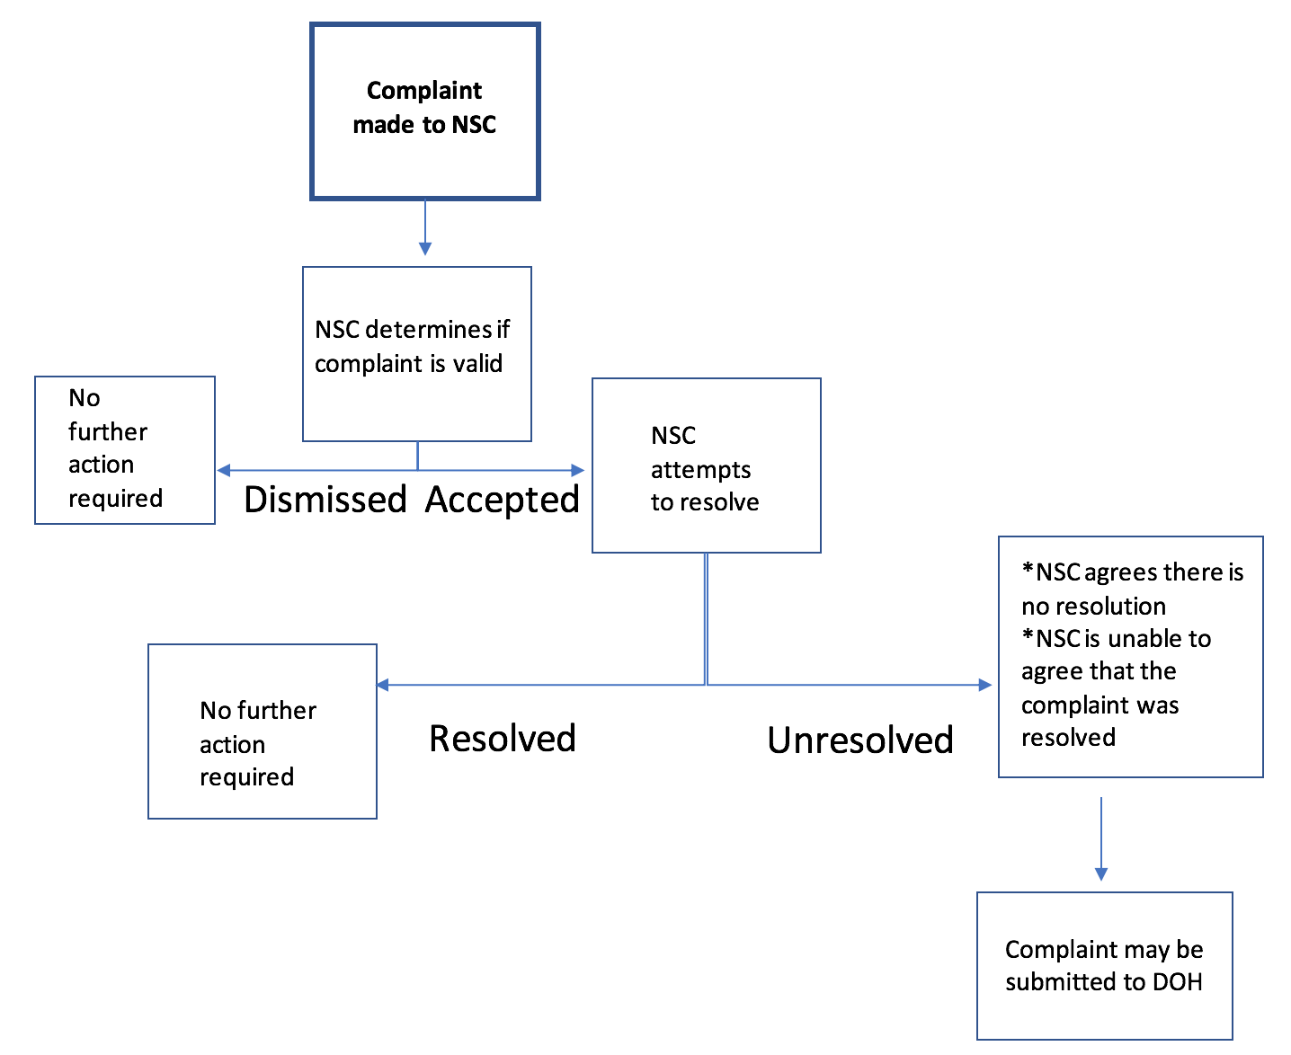
Assessing and Evaluating Complaints
Notes:
ANNE/SALLY

Slide 19
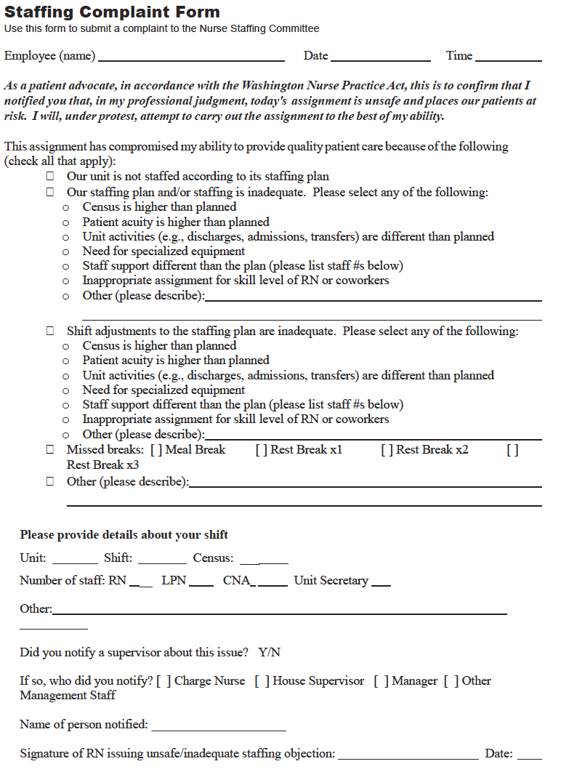
Sample Complaint Form
Notes:
IAN
Contains minimum standard elements and best practices recommended by Coalition
How to question an assignment
Reasons for complaint
Shift details
Charge nurse input
Nurse staffing committee follow-up

Slide 20
Sample Complaint Tracking Form
Notes:
IAN
Excel document to track
Complaints
Resolution
Time frame from received to resolved

Slide 21
A Renewed Focus on Staffing Committee Fundamentals and Data
Functioning staffing committees and good data will help resolve issues
Number and type of complaints received
Resolution of complaints
When and how complaint resolutions were conveyed to staff
Notes:
IAN

Slide 22
Tool Locations
http://www.wsha.org/our-members/resources-for-hospitals/2017-nurse-staffing-law-resources-and-tools/
https://www.wsna.org/nursing-practice/safe-nurse-staffing/resources-and-tools
https://www.seiu1199nw.org/2017-nurse-staffing-law-resources-and-tools/
https://www.ufcw21.org/ (Coming soon!)
Notes:
IAN

Slide 23
Discussion
What has been the experience with your staffing committee?
Notes:
IAN

Slide 24
THANK YOU!
Anne Tan Piazza, MBA – WSNA
206-575-7979 x 3006, apiazza@wsna.org
Ian Corbridge, MPH, RN – WSHA
206-216-2514, ianc@wsha.org
Jane Hopkins, RN – SEIU Healthcare 1199NW
206-245-5930, janeh@seiu1199nw.org
Sally Watkins, PhD, RN – WSNA
206-575-7979, swatkins@wsna.org
Samantha Grad, MPA – UFCW 21
206-436-6558, sgrad@ufcw21.org
Stacey Opiopio, UFCW 21
206-436-6573, sopiopio@ufcw21.org
Notes:
IAN

