Slide 1
Regional COVID-19 Coordination Center Overview
March 22, 2020
Notes:
Start with role call

Slide 2
Components of Integrated COVID-19 Planning
Coordinated surge planning and mitigation implementation
Crisis Standards of Care
Regional COVID-19 Coordination Center (RC³)
    Situational awareness
    Resource coordination
    Patient placement coordination
    Integration with crisis standards of care implementation

Slide 3
What’s the need
Overarching framework to coordinate across systems and institutions
    Transparency across the system
    Using all available resources to ensure we are doing the greatest good
    Mitigating crisis for as long as possible
    Managing crisis in a coordinated and consistent way – we all get there, and manage, together
No current single system exists to do this

Slide 4
RC³ Purpose & Concept
Coordinated, equitable placement of patients
Support from multiple partners:
    Washington State Department of Health,
    ocal health jurisdictions,
    healthcare coalitions,
    EMS agencies,
    Emergency management departments, and
    All Healthcare facilities

Slide 5
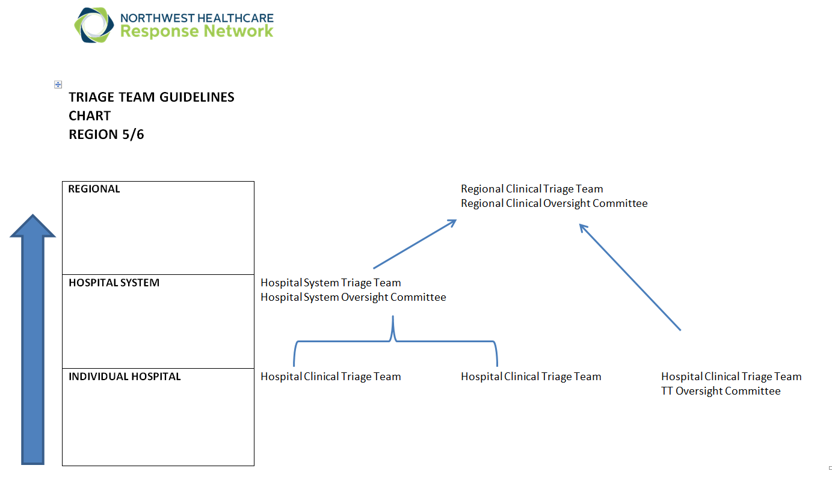
Triage Team Regional Structure
Regional COVID Coordinating Center (RC3)
CSC Clinical Triage Team

Slide 6
RC³ Support & Coordination
Developed in coordination with University of Washington Medicine & partners following Life Care Center of Kirkland support
Based on a Disaster Medical Coordination Center (DMCC) model
Single physical Center location (site TBD)
Regional CSC triage team provides clinical consultation
Seeking integration with EMS agencies
Integration into state response structures

Slide 7
RC³ Flow Diagram
RC3 Coordinator connects Referring physician or EMS with receiving hospital/physician for clinical report
Incoming call from outside facility or EMS
Physician or CSC Regional Triage Team identifies appropriate placement utilizing situational awareness tools, discussions with receiving facilities, and other relevant partners.
Notifies RC3 coordinator when placement is identified.
Call Received by RC3 coordinator. Coordinator collects basic information.
Discusses with designated physician or CSC regional triage team.
Referring MD/Facility arranges for transport of patient

Slide 8
What will it take
Cooperation: best available data
    WATrac, daily dashboards
    Exploring MST enhanced solution
Transparency about resource availability
Staff and logistics support
    Other clinical support
    Additional staffing to compliment DMCC, Coalition

Slide 9
Thank you

