Slide 1
Partnership for Patients
Safe Deliveries Roadmap
Learning Collaborative Webcast
November 5, 2013
Presented at Washington State Hospital Association Safe Table Webcast, 11/5/13

Slide 2
Safe Deliveries Roadmap Project Coordinator
Mara Zabari, Director of Integration Partnership for Patients
Washington State Hospital Association
206-216-2529
maraz@wsha.org
Presented at Washington State Hospital Association Safe Table Webcast, 11/5/13

Slide 3
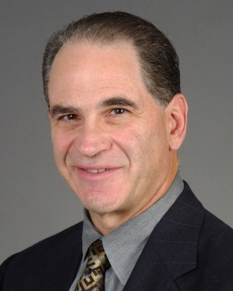
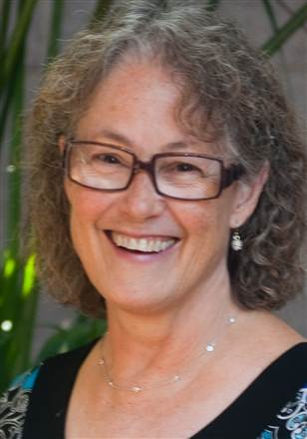
Project Leaders
Tom Benedetti, MD Dale Reisner, MD
University of Washington Swedish Medical Center
Presented at Washington State Hospital Association Safe Table Webcast, 11/5/13

Slide 4
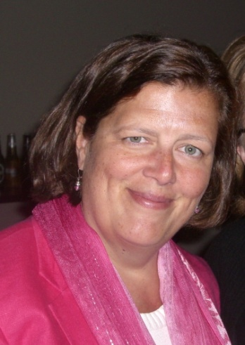
Safe Deliveries Roadmap Consultants
Kathleen Simpson
PhD, RNC, FAAN
Eric Knox, MD
Presented at Washington State Hospital Association Safe Table Webcast, 11/5/13

Slide 5
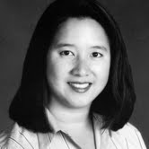
Featured Presenter
Angela Chien, MD
Presented at Washington State Hospital Association Safe Table Webcast, 11/5/13

Slide 6
Project Updates
Presented at Washington State Hospital Association Safe Table Webcast, 11/5/13

Slide 7
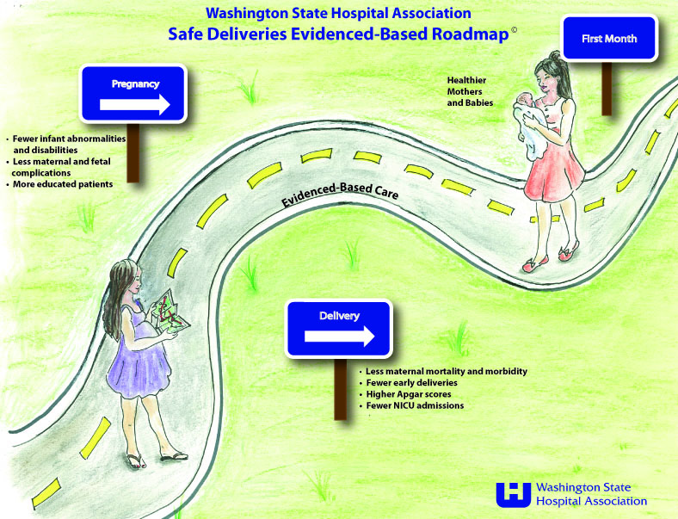
Coming Soon: Pre-Conception!
Presented at Washington State Hospital Association Safe Table Webcast, 11/5/13

Slide 8
Medicaid Quality Incentive
Presented at Washington State Hospital Association Safe Table Webcast, 11/5/13

Slide 9
Participating Hospitals
Cascade Valley Hospital and Clinics
Central Washington Hospital
Coulee Medical Center
EvergreenHealth
Group Health Cooperative
Harrison Medical Center
Highline Medical Center
Island Hospital
Jefferson Healthcare
Kittitas Valley Healthcare
Lake Chelan Community Hospital
Legacy Salmon Creek Medical Center
Mid Valley Hospital
MultiCare Auburn Medical Center
MultiCare Good Samaritan Hospital
MultiCare Tacoma General Hospital
Newport Hospital
Othello Community Hospital
Overlake Hospital
PeaceHealth Southwest Medical Center
PeaceHealth St. Joseph Medical Center
PeaceHealth Sacred Heart Medical Center, Oregon
PMH Medical Center
Providence Holy Family Hospital
Providence Mt. Carmel Hospital
Providence Regional Medical Center Everett
Providence Sacred Heart Medical Center & Children’s Hospital
Providence St. Mary Medical Center
Providence St. Peter Hospital
Pullman Regional Hospital
Samaritan Healthcare
Skagit Valley Hospital
St. Elizabeth Hospital
St. Francis Hospital
St. Joseph Medical Center – Franciscan Health System
Sunnyside Community Hospital & Clinics
Swedish/Ballard
Swedish /First Hill
Swedish/Edmonds
Swedish /Issaquah
Three Rivers Hospital
UW/University of Washington Medical Center
UW/Northwest Hospital & Medical Center
UW/Valley Medical Center
Valley Hospital/Rockwood Health System
Walla Walla General Hospital
Whidbey General Hospital
Whitman Hospital and Medical Center
Yakima Valley Memorial Hospital
Presented at Washington State Hospital Association Safe Table Webcast, 11/5/13

Slide 10
Leading Edge Advanced Practice Topics LEAPT
Kittitas Valley Healthcare
Legacy Salmon Creek Medical Center
Overlake Medical Center
PeaceHealth St. Joseph Medical Center
Providence Holy Family Hospital
Providence Sacred Heart Medical Center and Children’s Hospital
Providence St Peter Hospital
Samaritan Healthcare
Swedish/Ballard
Swedish/Edmonds
Swedish/First Hill
Swedish/Issaquah
Three Rivers Hospital
UW Medicine/Northwest Hospital & Medical Center
UW Medicine/Valley Medical Center
Whidbey General Hospital
Yakima Valley Memorial Hospital
Presented at Washington State Hospital Association Safe Table Webcast, 11/5/13

Slide 11
Meeting Schedule
2013
Monthly (webcast) 7:00 am – 8:00 am
December 5th
Safe Table (in-person) 9:00 – 2:30 pm
November 19th
2014
Monthly (webcast) 7:00 am – 8:00 am
January 9
February 21
March 26
April 23
May 20
June 12
Safe Table (in-person) 9:00 am – 2:30 pm
April 1
July 24
November 20
CANCELLED!
Presented at Washington State Hospital Association Safe Table Webcast, 11/5/13

Slide 12
Upcoming Safe Table November 19, 2013 9:00 am – 2:30 pm
Intrapartum Fetal Assessment
Checklists and algorithms
Measures and Data collection
Latest Early Elective Delivery and Episiotomy reports
Implementation plan for 2014
Presented at Washington State Hospital Association Safe Table Webcast, 11/5/13

Slide 13
Featured Presentation
Presented at Washington State Hospital Association Safe Table Webcast, 11/5/13

Slide 14
Cesarean Section Rates
Dr. Angela Chien
November 5, 2013
Presented at Washington State Hospital Association Safe Table Webcast, 11/5/13

Slide 15
Cesarean Section Rates
Presented at Washington State Hospital Association Safe Table Webcast, 11/5/13

Slide 16
Cesarean Section Rates
Data is limited in that only includes deliveries done by general OB/GYNs (excludes hospitalists, MFM, midwives)
This is about 90% of deliveries at Evergreen
Labor was allowed in 76% of our patients consistently over the three year period
Presented at Washington State Hospital Association Safe Table Webcast, 11/5/13

Slide 17
Cesarean Section Rates—First Stage
Overall reduced rate of 1st stage CS, predominantly in INDUCED population
In INDUCED population, this is both in management of dystocia and fetal tracing concerns
Presented at Washington State Hospital Association Safe Table Webcast, 11/5/13

Slide 18
Cesarean Section Rates—Second Stage
There has been reduction in CS being done for 2nd stage dystocia in both induced and spontaneous labor populations
Presented at Washington State Hospital Association Safe Table Webcast, 11/5/13

Slide 19
Inductions
Presented at Washington State Hospital Association Safe Table Webcast, 11/5/13

Slide 20
WHAT ABOUT THE REST OF BREE?
Presented at Washington State Hospital Association Safe Table Webcast, 11/5/13

Slide 21
Do we have a different patient population?
Presented at Washington State Hospital Association Safe Table Webcast, 11/5/13

Slide 22
QUESTIONS?
Presented at Washington State Hospital Association Safe Table Webcast, 11/5/13

Slide 23
Meeting Schedule
2013
Monthly (webcast) 7:00 am – 8:00 am
December 5th
Safe Table (in-person) 9:00 – 2:30 pm
November 19th
2014
Monthly (webcast) 7:00 am – 8:00 am
January 9
February 21
March 26
April 23
May 20
June 12
Safe Table (in-person) 9:00 am – 2:30 pm
April 1
July 24
November 20
CANCELLED!
Presented at Washington State Hospital Association Safe Table Webcast, 11/5/13

Slide 24
Questions?
Mara Zabari, Director of Integration Partnership for Patients
206-216-2529
maraz@wsha.org
Safe Deliveries Roadmap Website
http://www.wsha.org/0513.cfm%20
Presented at Washington State Hospital Association Safe Table Webcast, 11/5/13

