Slide 1


Post-Fall Huddle and Data Analysis
It Starts with You…
Preventing Falls
Improving Lives
2014 Fall Prevention Education Series brought to you by the Washington State Hospital Association

Slide 2
Why focus on preventing falls?
30% of Inpatient Falls Result in Serious Injury
Preventing falls:
Increases patient trust
Improves care
Improves patient satisfaction
Decreases unnecessary costs for both the patient and the hospital
Reduces Risk of Injury to the Caregiver
Notes:
Why should we focus on preventing falls?
According to evidence-based research, out of all inpatient incidents, such as medication errors, pressure ulcers, hospital-acquired pneumonia or surgical site infections, 84% are patient falls. An estimated 30% of inpatient falls results in serious injury, such as a fracture, subdural hematoma, injury requiring surgery, or death. A serious injury due to a fall increases the average length of stay by 6.27 days – increasing the risk of other potential complications, such as pressure ulcers, infections or medication errors. Preventing a patient from falling increases patient comfort, patient & family satisfaction, and confidence in the care they are being provided.
How does preventing falls keep health care workers safe?
According to the Bureau of Labor Statistics, six of the top ten professions with greatest risk of back injuries are: Nurse’s Aides, LPNs, RNs, Health Aides, Radiology Techs, and Physiotherapists. 38% of RNs and 42% of all Direct Caregivers suffer injuries as a result of patient handling activities.
Preventing additional patient handling that will be required after a patient falls is definitely in your best interest. Ensuring you have a fall prevention plan with every patient actually improves your safety and work satisfaction. Identifying and reducing the risk for patient falls often reduces staff workload.
How do patient falls impact the health care system as a whole?
Falls are considered preventable in most cases. The morbidity, mortality and financial burdens attributed to patient falls in hospitals and other healthcare settings are among the most serious risk management issues facing the healthcare industry today.
Preventing falls:
Increases patient trust.
Improves quality of care and patient and family satisfaction
and decreases unnecessary costs for both the patient and the hospital.

Slide 3

What can I do to prevent falls?
Leadership & Frontline Staff Involvement
Identify Fall & Injury Risk Patients
Fall Prevention Interventions
Patient/Family Engagement & Culture
Monitor Performance
Notes:
The Washington State Hospital Association Fall Prevention Safety Action Bundle is an evidenced-based document outlining five core strategies necessary for preventing falls. This presentation is focused on the importance of screening patients and identifying those who are at risk for fall and injury.

Slide 4

Safety or Shift Huddles
Occur at beginning of each shift
Multiple staff and leader involvement
Identify patients at risk for skin breakdown, infection or falls
Notes:
Safety huddles or shift huddles occur at the beginning of each shift and are important for identifying high risk patients, such as those at risk for skin breakdown, infection or falls.
This is different from a post-fall huddle. A Safety or Shift Huddle is a part of fall prevention communication efforts. This type of communication alerts the entire care team about high risk patients and can also be a conduit for ensuring appropriate interventions are in place. A Safety or Shift huddle is completed to warn the team about potential safety hazards. The safety or shift huddle should be organized around relevant questions such as who are at most risk and why are these patients at risk and what are we doing about it?

Slide 5

Post-Fall Huddle
Immediate
Patient care team
Discuss safety issue
Identify potential concerns
Notes:
Research has shown that there are both immediate and long-term safety implications to performing a post-fall huddle. But first, what do we mean by a post fall huddle? What is it?
Post fall huddles provide a mechanism to learn from falls by immediately assessing the situation and reviewing the event.
A post fall huddle typically involves the gathering of a multi-disciplinary group, often including the patient and/or family, to discuss the situation leading up to the patient fall and asking the huddle team several pertinent questions to identify if there are any immediate process improvements that need to be made as well as gather information to identify long-term trends. The post-fall huddle process and information required is typically defined by individual organizations.

Slide 6

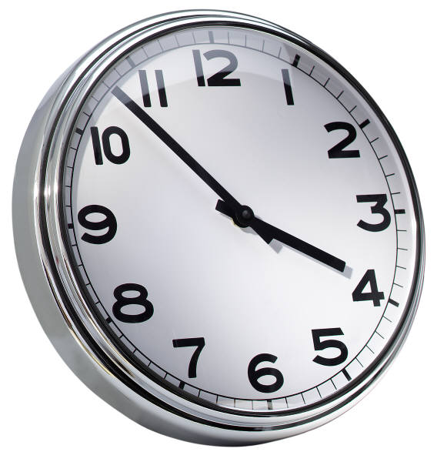
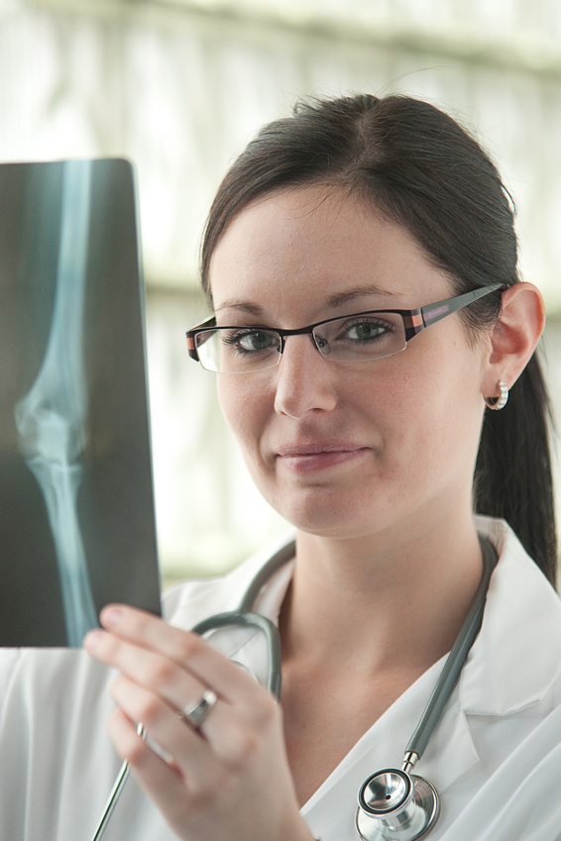
Components: Post-Fall Huddle
Date & Time of Fall
Location & Admitting Diagnosis
Notes:
Understanding why it is important to obtain the components of the post-fall huddle will help justify the time everyone takes to complete a post-huddle and give you a better understanding of how you can make both an immediate and long-lasting impact on patient safety.
One of the main reasons, besides basic documentation procedure, to include the date, time, location and diagnosis is to provide information that may be used to identify trends and improve processes. For instance, if during the past few months the data collected from post fall huddles revealed that 65% of the falls that occurred happened on the weekend night shift on the 3rd floor surgical unit or that 35% of the patient falls were patients diagnosed with Congestive Heart Failure, this would be great information to have to complete a deeper dive into cause. A focused group can really look at root causes armed with trended data. If all we knew was we had 8 falls in two months, there would not be a precise way to look at making process improvements.

Slide 7
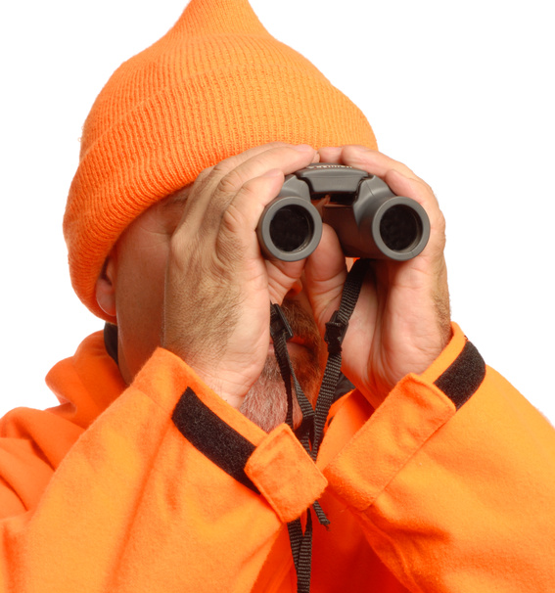
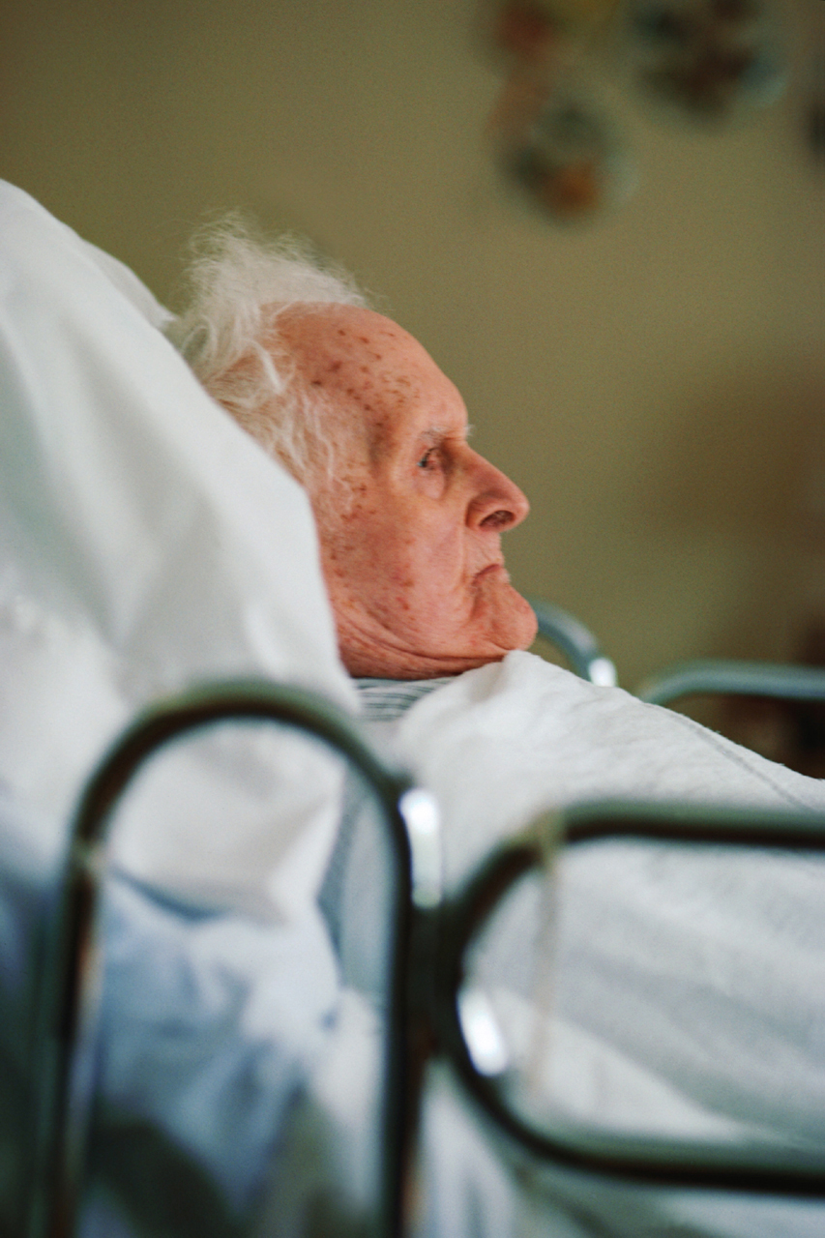
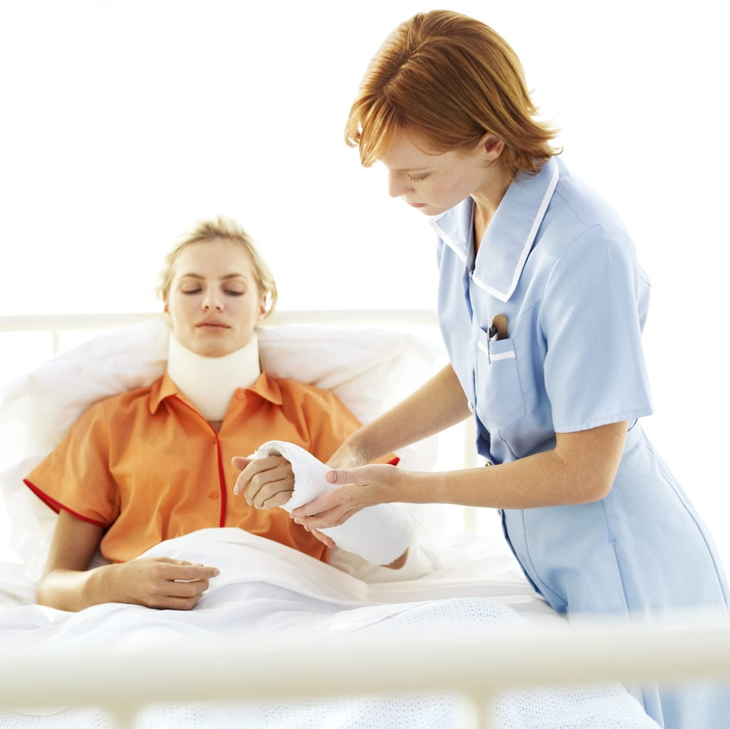
Components: Post-Fall Huddle
Last known time patient was visibly assessed (<1hr, 1-2 hr or >2hrs)
Assisted or unassisted fall
Observed or unobserved fall
ANY physical injury (includes pain)
Any and all interventions performed as a result of the fall
Notes:
Identifying the last known time the patient was assessed will help identify if there was a breakdown in process and the patient had not been checked on for 3 hours or did a staff person just leave the room and the patient fell. Also, with last known assessment, it is important who did last see the patient. Was there anything unusual about the patient? Any change in patient status? Were the six P’s performed? Toileting, pain control, positioning for comfort, personal needs such as thirst hunger or temperature, proximity of call bell, personal items, and pulmonary (respiratory status) and/or pump (IV fluids and alarms).
Was the fall observed or unobserved? Assisted or unassisted? And if so, by whom? This data is helpful when research is necessary to review a case.
Of course it is imperative to know if the patient suffered any injuries in the fall. American Nurses Association defines a falls with injury as anything from minor – resulting in pain, applying a dressing or ice to moderate with suturing and splinting to major fractures, surgery, hemorrhage and death. So, as with any injury, there should be an intervention and these need to be completed and documented as well. It goes without saying, the patient comes first in any situation, so always take care of any immediate needs of the patient, then accomplish the post-fall huddle.

Slide 8

Components: Post-Fall Huddle
Prior to fall:
What was the patient trying to do?
Using an assistive device?
Had IV or Oxygen tubing?
Risk assessment completed?
Interventions were in place?
Notes:
Other important points to acknowledge after a fall is what the patient was doing prior to the fall. These are helpful to assist in educating the patient, family, and ensuring that potential hazards are taken care of swiftly. For instance, if the patient fell while trying to use their walker to get out of bed, you may want to have physical therapy notified for education and reinforcement of device use. Or, if the patient was a high fall risk but the bed alarms were not turned on, this would be important to note for trending and educational purposes.

Slide 9

Components: Post-Fall Huddle
Previous falls while in hospital?
Did devices contribute to fall?
Did medications that could contribute to fall risk?
Other Factors that may have contributed:
  Staff Qualifications
  Supervision and Support
  Environment
  Policies and Procedures
  Human Factors
Notes:
There are numerous other components that assist with identifying ways to immediately improve the safety on your units and also to identify what potential long-term trends need to be looked at more closely.
Were there any previous falls while admitted? This admission or previous one?
Did any devices we applied contribute to the fall? Such as restraints or sequential compression device?
What medications may have contributed to the fall?
Other factors include: staff qualifications, supervision/support, environment, policies/procedures, human factors or any other patient contributing factors

Slide 10

Who is involved?
TEAM EFFORT!
Anyone on the unit who is involved in the operations and
clinical outcomes should be involved!
Patient Safety is only Accomplished through Teamwork
Notes:
Ok, so we know what we should be asking and documenting, but who should be involved?
Anyone on the unit who is involved in the operations and clinical outcomes should be involved in the post-fall huddle, so long as no other patients are placed in jeopardy of course. Everyone can and should learn from each and every fall. Also, everyone discipline should be engaged in reducing patient falls for every patient. (click)This leads to trust, better team work, and the joint ownership.
At the very minimum, the team who should be involved is, the primary nurse and aide along with the patient and/or loved one if available. Ideally, therapy, pharmacy, housekeeping, the attending physician, other nurses and aides as available should attend. So, when should we conduct a post-fall huddle?

Slide 11
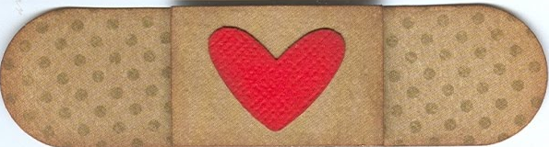
Timing is Everything
Patients First
Conduct post-fall huddle
as soon as feasible
Immediately act on any pertinent findings
Notes:
First things first – take care of the patient. Make sure the patient is not in any immediate danger and has received the necessary medical and nursing care post-fall. This includes ensuring that the patient is calm, emotionally comfortable and not in any pain. In the best of circumstances, involve the patient and/or loved ones in your post-fall huddle. This not only helps to answer some questions that may come up about the happenings prior to the fall, but also shows the patient and family how serious you are about making sure that another fall does not occur. Conduct your post-fall huddle as soon as feasible possible. Postponing the post-fall huddle diminishes memory and can even allow for the same issue to happen again with another patient! Timing is everything.

Slide 12

Why do post-fall huddles work?
Post-fall huddles provide information to identify what went wrong and how to prevent falls in the future
Effective communication is essential for a culture of safety
Notes:
Post-fall huddles work because they give the necessary information to identify what went wrong and how to prevent falls in the future. We also know that effective communication is essential for a culture of safety. A post-fall huddle gives the team a prescribed venue to communicate effectively and consistently.

Slide 13
Why do I need to collect data?
Post-fall huddles provide important data to identify trends and to fix problem areas
Notes:
Data collection for falls analysis is important for several reasons, including identifying trends based on shift, day of week, location, type of patient, fall circumstance and injury level. If trends over time show a higher incidence of falls occur on weekends or on the surgical unit, this may indicate a staffing effectiveness concern or may be related to education on fall prevention. Trends allow for root cause analysis at an aggregate level for identifying potential bigger process, policy or educational issues that need to be remedied. Without data, we don’t know what problems we have to start fixing them. The post-fall huddle gives us the data we need to identify trends.

Slide 14
Knowledge is Power
How data is used to change practice?
Examples for Fall Prevention include:
Policy Changes
Education Requirements
Equipment Needs
Staffing Effectiveness
Medication Formularies
Patient Room Organization
High Risk Assessments
Fall Prevention Intervention
Notes:
Data provides the necessary evidence to drive change throughout an organization and at the unit level. Almost every aspect of health care is driven by evidence-based practice, which means data collection and trending is analyzed and validated to provide a baseline of what is working and what is not working. A few examples of changes that can occur based on data analysis are: education, equipment needs and policy changes.

Slide 15
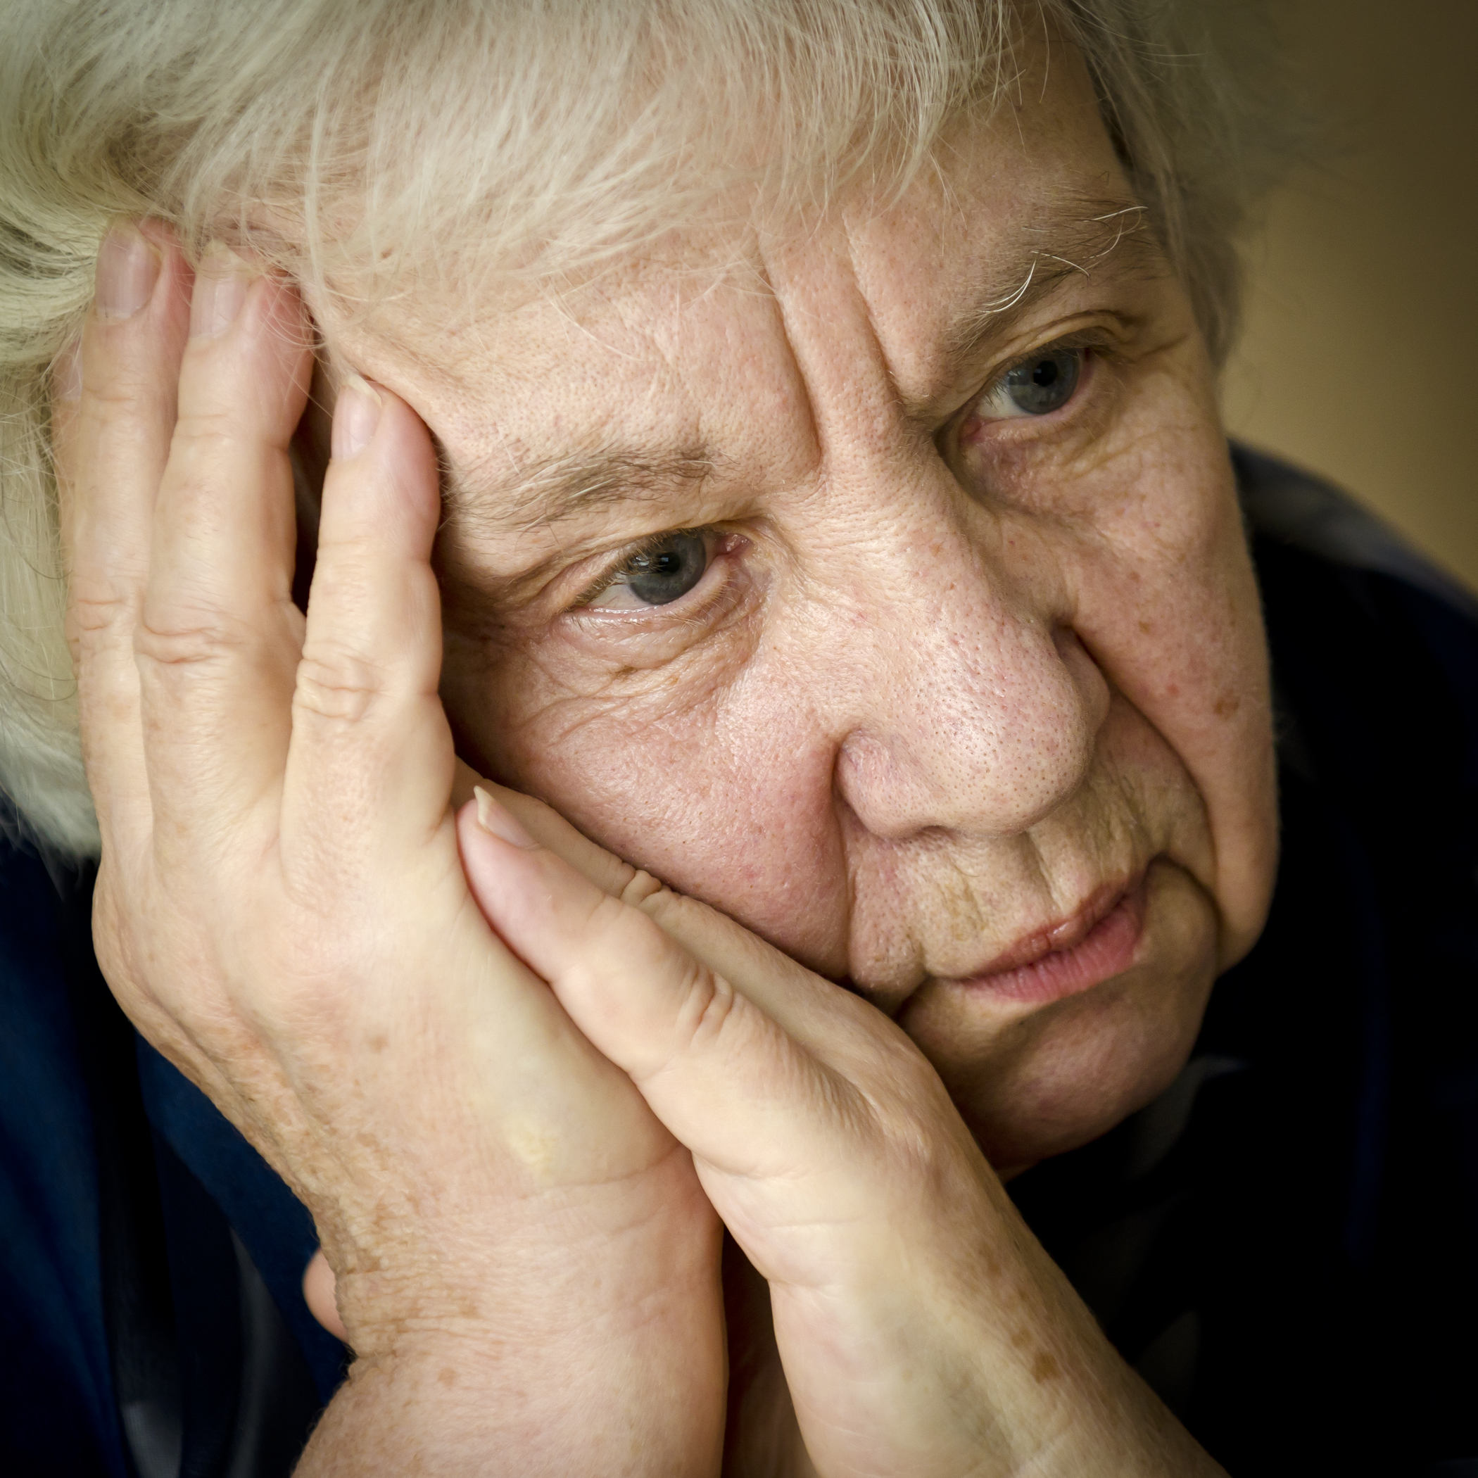
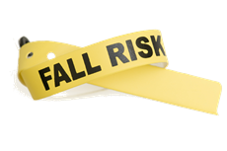
Mrs. Jesse
Demographic Information: 75 year old female
Admitted with: Exacerbation Congestive Heart Failure
Social Situation: Home Alone
Medications: Lasix, Vasotec, Coreg, Aspirin,
Fall History: per patient 2-3 times in last six months, minimal injury at home
Additional Observations: Stoic and wants to be as independent as possible
Notes:
Let’s work through a case study together. Mrs. Jesse, a 75 y/o female admitted for congestive heart failure, fell after getting up from the bedside commode. She was finished and thought that the commode was close enough to the bed that she could get up on her own and get back to bed. She felt as though she had been using the call light too often to get help to the bathroom and did not want to bother anyone. She states she felt lightheaded once she stood up and when she tried to sit back down on the commode, she misjudged the seat and fell instead. This was not witnessed as the aide that assisted her the bedside commode left the room to answer another call light and did not return for several minutes. Mrs. Jesse states she did not hit her head, but she was found lying supine on the floor.

Slide 16
Mrs. Jesse Post-Fall
What steps do you take next?
Assess immediately for any injury
Identify immediate needs of patient and attend to those needs
As soon as feasible, all a post-fall huddle
Identify and document pertinent items on the post-fall huddle form
Notes:
What do you do immediately?
Assess patient for injuries and determine if she is any immediate danger from the fall
Mrs. Jesse’s immediate assessment revealed some redness and tenderness to her sacral area, a skin tear on her right forearm and very anxious from the fall, otherwise she is stable.
With assistance, help Mrs. Jesse to her bed and call a post-fall huddle with those involved and who is available on the unit, including the primary nurse, aides, pharmacists, physical therapy, housekeeping, physician and case management.

Slide 17

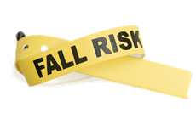
Mrs. Jesse
What key areas do you discuss in the post-fall huddle?
Date, time, location, and diagnosis
Interventions and injuries
Pharmaceutical contributing factors
Prior to fall information
Environmental contributing factors
Prevention strategies used
Notes:
There are numerous key components for data collection post patient fall. Your hospital process may include more than we have discussed, however, the basic components are:
- date, time, location and diagnosis
Whether there were any injuries and what interventions have been done
Was the patient on any medications that could have contributed to the fall?
Any pertinent information related to immediately before the fall – including call light location and use
What environmental factors could have contributed? Were there too many obstacles or the patient tripped over the IV pole?
What were the prevention strategies in place before the fall?

Slide 18
What have we learned?
Falls are major contributor to a patient’s functional decline
Even without a major injury, the psychological and emotional trauma can cause diminished quality of life
Falls with injury can:
  Cause lasting pain
  Limit activities of daily living
  Increase the likelihood of skilled nursing placement
Notes:
Falls are a major contributor to a patient’s functional decline and increased healthcare use. Even if a fall doesn’t cause a serious injury, it may triple the patient’s likelihood of requiring placement in a skilled nursing facility. A serious fall increases the likelihood of skilled-nursing placement nearly tenfold. A fall can cause lasting pain and suffering and may limit function, imposing additional family and societal care burdens. Preventing falls and reducing the likelihood of injury is everyone's issue in the hospital. A culture of safety and awareness is imperative to reduce the incidence of falls is necessary to keep your patient’s safe. It starts with you…

Slide 19
Other presentations in this series
Fall Risk Assessment
Fall Prevention Interventions,
Patient and Family Engagement
Post-Fall Huddles and Analysis
Brought to you by the Washington State Hospital Association
Notes:
Two other presentations available in this Fall Prevention Series. The Fall Risk Assessment presentation reviews the importance of fall risk assessments. The Fall Prevention Interventions presentation reviews recommended fall prevention interventions, ideas on how to engage patients and families in preventing falls and how you and your team can embed fall prevention into daily practice.

Slide 20
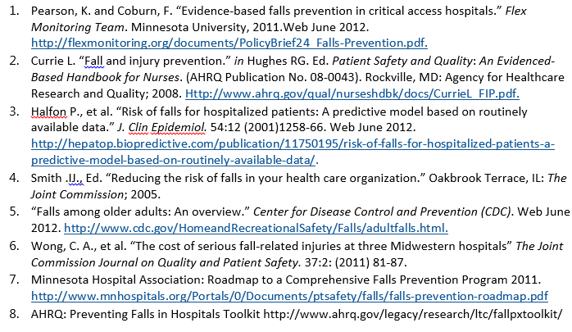
Resources
Notes:
Resources used to develop the content for this presentation

