Slide 1
What You Need to Know About Cyber Insurance

Slide 2
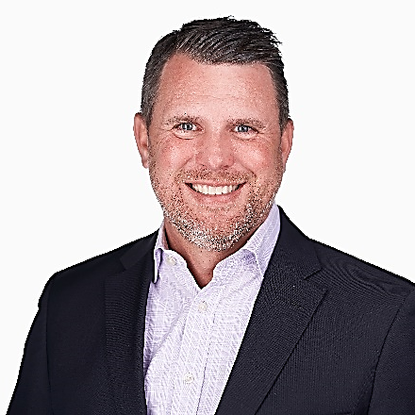
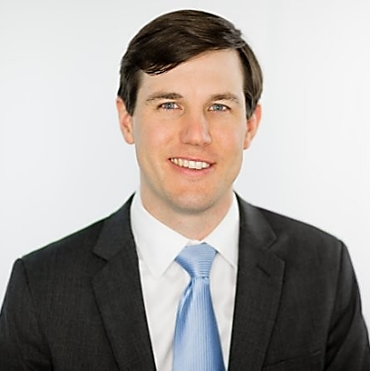
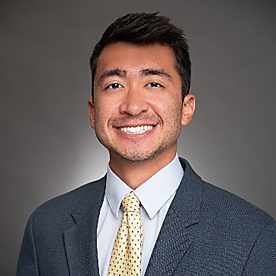
Parker, Smith & Feek - Cyber Placement Team
RYAN ROBERT National Healthcare Specialty Leader
HUNTER MASKILL Managing Director
MICHAEL UJJIN Senior Broker

Slide 3
Cyber Coverage 101

Slide 4
What Does a Proper Cyber Policy Cover?
Incident Response:
Legal
Forensics
Notification
Credit Monitoring
Public Relations
Extortion Expenses:
Investigation
Negotiation
Cryptocurrency Payments
OFAC, AML, KYC Checks
Crime:
Social Engineering
Invoice Manipulation
Cryptojacking
Traditional crime coverage
Business Interruption:
Lost Profit
Extra Expenses
Data Restoration
Cyber Liability:
Lawsuits
Regulatory Fines
PCI Fines
Media Liability:
Infringement
Libel, Defamation, Slander

Slide 5
Ransomware Claim Example

Slide 6
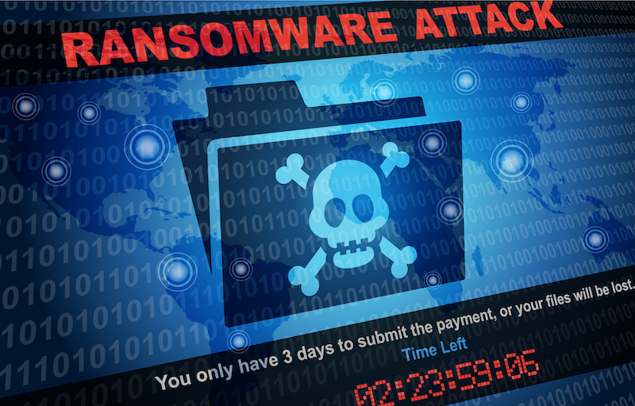
Ransomware Claim Example
Hospital System Hit by Ransomware
Operational due to backups
Patient & employee data exfiltrated
Billing data lost / encrypted
Cost to recreate data decision to pay ransom
How does business interruption fit into the equation?
Negotiation & payment
Post-payment

Slide 7
Ransomware Trends Overview
Puppydog21
Average Payment in Q2 of 2022 was $228k
For Mullen Coughlin, avg payment in 2021 was $521k with avg demand of $2.1M through over 1,100+ incidents.
Average downtime from an attack has grown to 24 days and is the largest source of losses.
Estimated one group (Revil) collected $100M alone in first half of 2021. Then they vanished from the Internet overnight in July ‘21. Their code has recently reappeared.
49% of attacks are on companies with 1-100 employees.
Healthcare accounted for roughly 20% of ransomware attacks in Q2
Exposed RDP and phishing continue to be the lead causes for over 60% of attacks.
86% of attacks involve Data Exfiltration.
*Source Coveware & Kroll Reports

Slide 8
Current State Of The Market

Slide 9
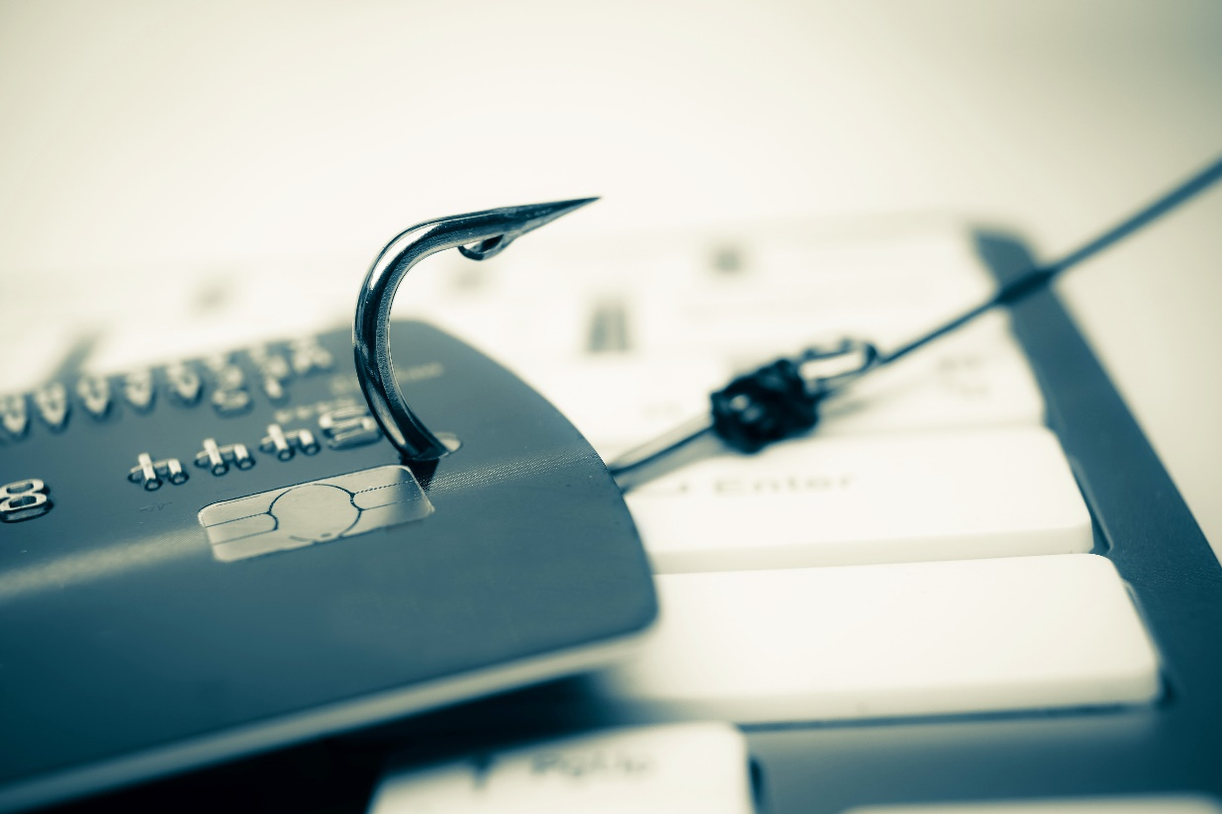
What is Changing?
Factors Influencing the Market
Direct Carrier Loss Ratios
Reinsurance Markets & Capacity
Old Pricing Models
New Underwriting Questions
Rigid Underwriting Models / Guidelines
Is Your Risk Insurable?

Slide 10
How to be Viewed as a Good Risk

Slide 11
Timeline & Partnerships
Midterm Discussion on Controls
Application Review & Discussion on Scanning Technology
Put Your Best Foot Forward
Need for Diversity in Markets
Notes:
Whether expect large increase, potential coverage reduction, controls that may hinder from getting favorable terms
We’ll look over the app to talk through potential areas of concern
Differentiate by being involved in the claims process. Nothing too much, but set tasks to follow up at set timelines to ensure claim is moving forward as expected
Over $1M book with 25 markets, 17 with $2M+. Beneficial in current market for tough to place risks

Slide 12
Controls that Matter
Puppydog21
Multifactor Authentication (MFA)
Remote Access to Network
Remote Access to Email
Privileged Accounts
Backups
Backups
Disconnected
In the Cloud
Encrypted
Restricted Access
Tested
Employee Training
Consistent Messaging
Testing of Employee
Response to Failed Tests
Endpoint Detection & Response (EDR)
Behavioral-based AV
Servers and workstations
How is it monitored?
Patching
Standard Cadence
Scanning for Success
Critical Patches
BC / DR / IR
Documented Plan
Tested
Established RTO’s
Notes:
Free services available for all InsureTrust clients, exception ongoing monthly monitoring
Vulnerability scan run by Fortify Data

Slide 13
Contacts
Danielle Donovan
Clinical Risk Manager
(425) 709-3600
dmdonovan@psfinc.com
Ryan Roberts
VP, Account Executive
(425) 709-3786
reroberts@psfinc.com

