Slide 1
COVID-19 Clinician Support
June 23, 2020

Slide 2

Raise your hand to speak – we will unmute you.
Make sure you aren’t self muted
Do not put the call on hold or answer another line.

Slide 3
Agenda
Epi Report
IHME Predictive Model
Q&A with John Lynch, MD, MPH, UW Harborview Medical Center
  Topics to include Remdesivir, surge triggers, pandemic policies and more
DOH Resumption
We will have discussion and Q&A throughout the call. Use the “raise hand” function if you have a question or comment.

Slide 4
COVID-19 projections
Steve Lim
June 22, 2020

Slide 5
Covid Model Development over the past 3 months
CurveFit
Mar 26 – May 3
Curvefit-SEIR Hybrid
May 4 – June 10
RKCS-SEIR Hybrid
June 11-
Statistical, deaths-based model
Performed well initially for locations with >50 deaths
Focused on predicting initial peak of hospital resource use as a function of social distancing
Did not predict decline after the peak well
Mixture of CurveFit and SEIR
Fitted a statistical model to the past and next 8 days; and an SEIR model to predict after 8 days
Future transmission a function of covariates: mobility, testing, temperature, pop density
Better fit to observed declines after peak
Analysis of cases, hospitalizations, and deaths to estimate past & next 8 days
Fit an SEIR model to these trends
Future transmission a function of covariates: mask use, human contact rates, pneumonia seasonality, testing per capita, population density, PM2.5, smoking, altitude, pneumonia death rate

Slide 6
Cases and deaths in Washington
King and Snohomish
Other counties besides King, Snohomish and Spokane

Slide 7
Key drivers of cases and deaths: Seasonality
Pneumonia Deaths by Week in the United States

Slide 8
Mobility based on cell phone and location-based app use

Slide 9
No. of contacts outside of household in last 24 hours

Slide 10
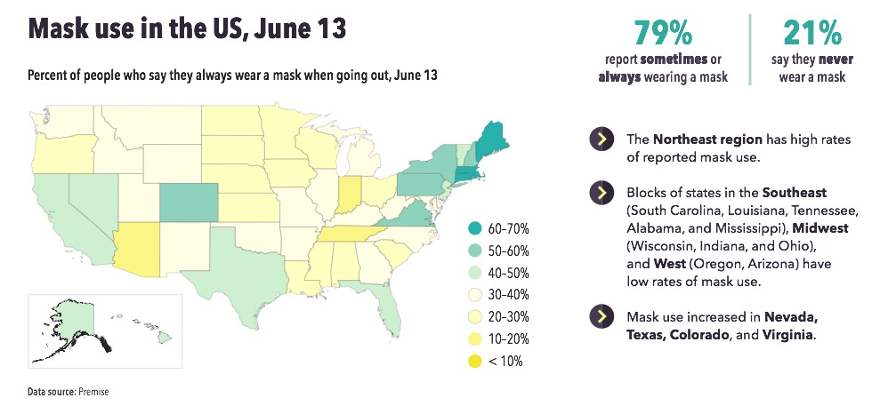
Washington State

Slide 11
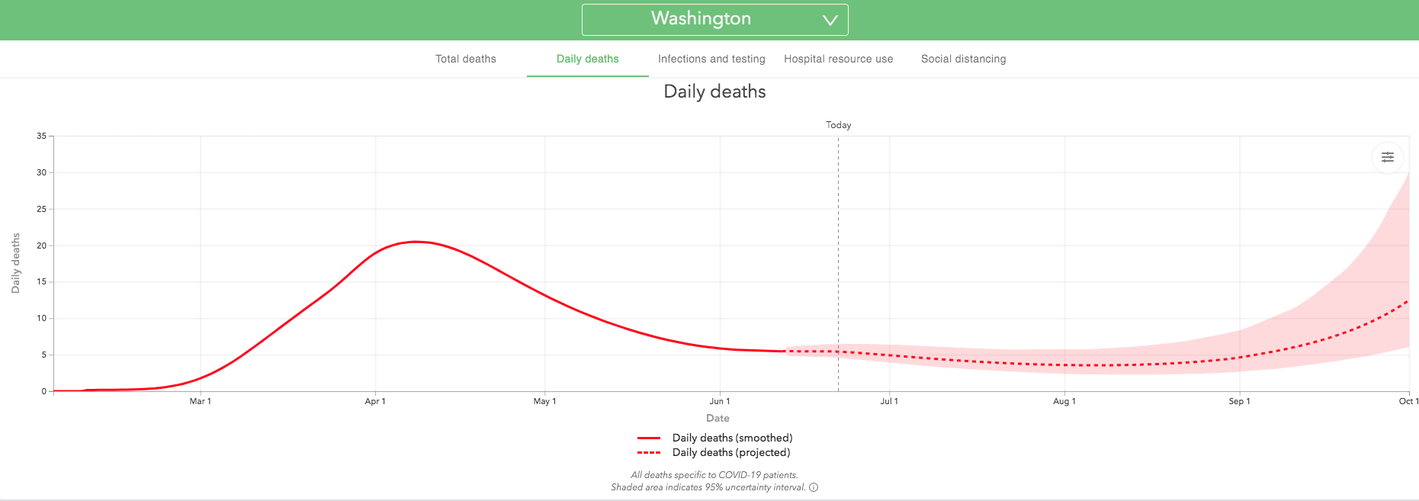
If progressive relaxation of mandates and mobility increase continues in Washington State

Slide 12
Hospital resource use implications – UW Medicine system

Slide 13
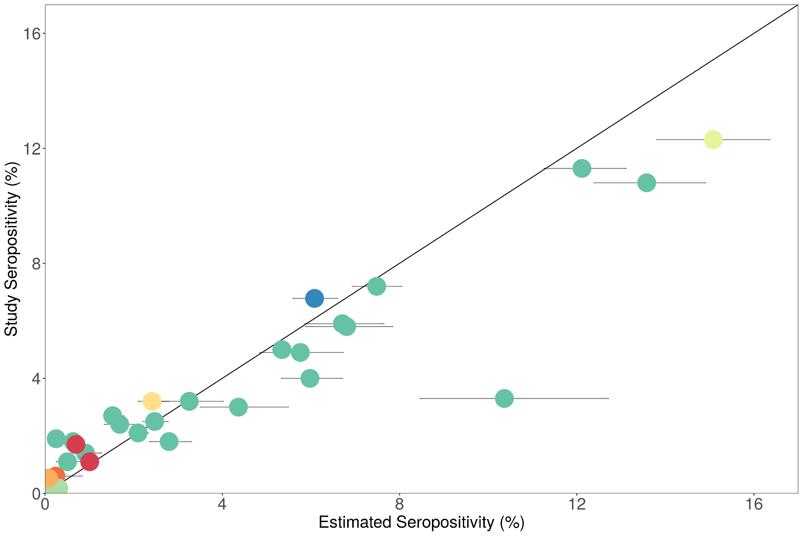
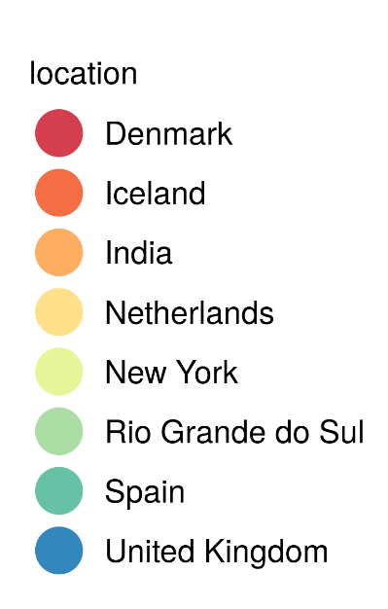
Measured antibody sero-prevalence vs model predictions
  New York, USA
  Community of Madrid, Spain
  Castilla la Mancha, Spain
  La Rioja, Spain
Notes:
Scatterplot of antibody sero-prevalence vs our model predictions of sero-prevalence, outliers labeled by location (Theo / David P)

Slide 14
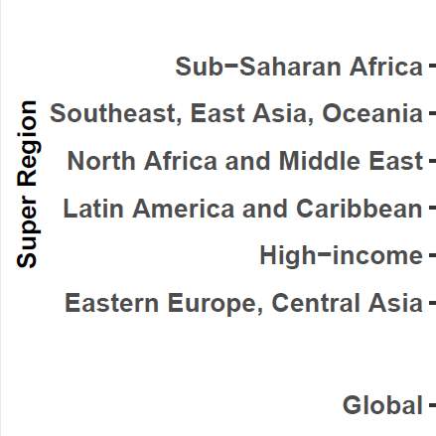
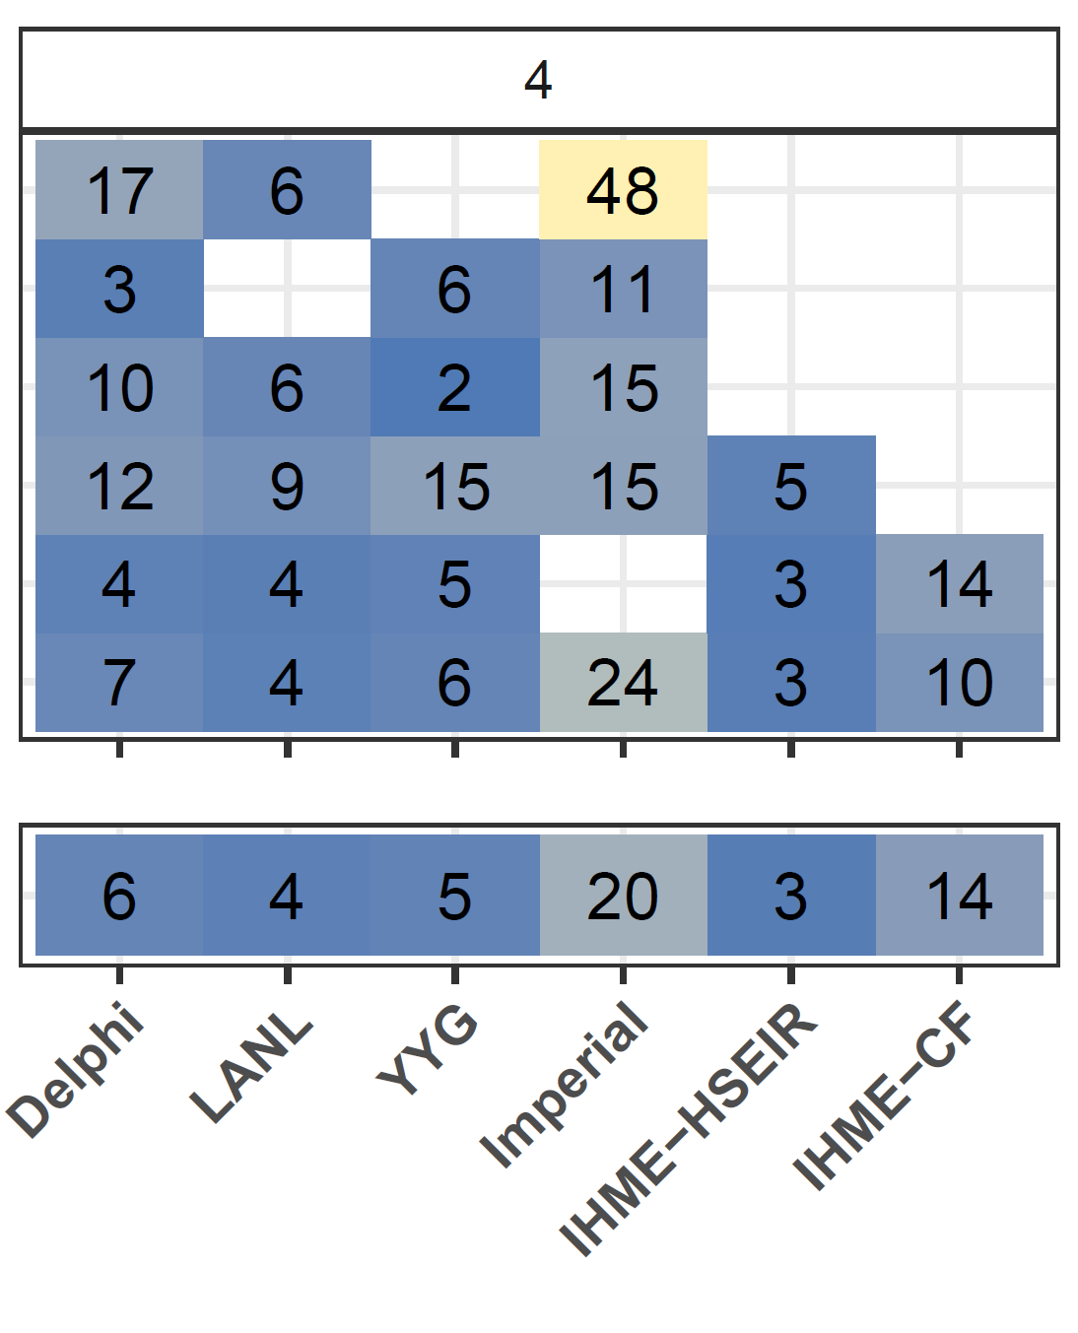
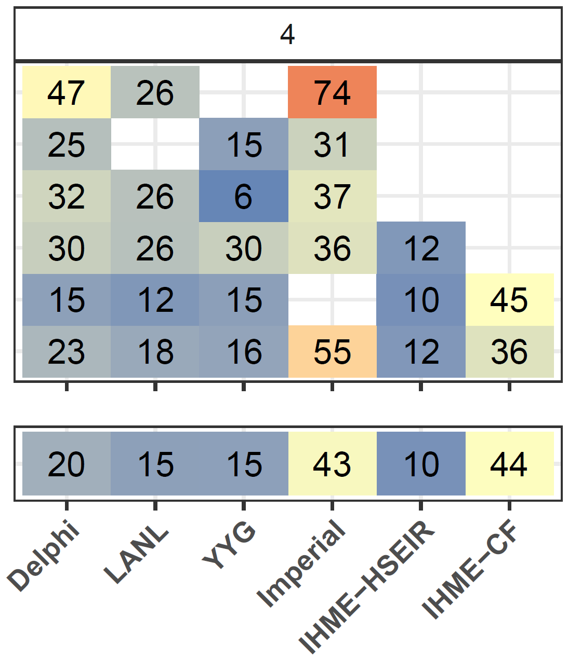
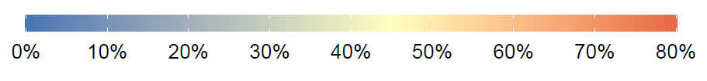
Median Absolute Percent Error at 4 Weeks From Forecasting Start Date
Weekly Error
Cumulative Error

Slide 15
What’s coming next
Extend prediction timeframe through January 1st
Estimates of deaths, infections for race/ethnicity groups
Alternative scenarios based on
  Scale-up of mask wearing
  Re-imposition of some mandates when case/death rate exceeds a critical threshold
  Intermittent mandates

Slide 16
Agenda
Epi Report
IHME Predictive Model
Q&A with John Lynch, MD, MPH, UW Harborview Medical Center
  Topics to include Remdesivir, surge triggers, pandemic policies and more
DOH Resumption
We will have discussion and Q&A throughout the call. Use the “raise hand” function if you have a question or comment.

