Slide 1
COVID-19 Clinician Support
May 19, 2020

Slide 2
Raise your hand to speak – we will unmute you.
Make sure you aren’t self muted
Do not put the call on hold or answer another line.

Slide 3
Agenda
Hospital Visitor Policies
Fall Surge Planning
We will have discussion and Q&A throughout the call. Use the “raise hand” function if you have a question or comment.

Slide 4
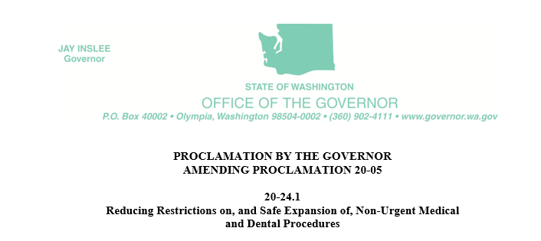
Use on-site fever screening and self-reporting of COVID-19 symptom screening for all patients, visitors and staff prior to (the preferred approach), or immediately upon, entering a facility or practice.
Post signage that strongly encourages staff, visitors and patients to practice frequent hand hygiene with soap and water or hand sanitizer, avoid touching their face, and practice cough etiquette.
Maintain strict social distancing in patient scheduling, check-in processes, positioning and movement within a facility. Set up waiting rooms and patient care areas to facilitate patients, visitors and staff to maintain ≥6 feet of distance between them whenever possible, consider rooming patients directly from cars or parking lots, space out appointments, and consider scheduling or spatially separating well visits from sick visits.
Limit visitors to those essential for the patient’s well-being and care. Visitors should be screened for symptoms prior to entering a health care facility and ideally telephonically prior to arriving. Visitors, who are able, should wear a mask or other appropriate face covering at all times while in the health care facility as part of universal source control.
….shall remain in effect until the state of emergency, issued on February 29, 2020, pursuant to Proclamation 20-05, is rescinded, or until this order is amended or rescinded, whichever occurs first.

Slide 5
Goal 4: Begin development of fall surge plan
Description: Develop recommendation to prepare Washington state for anticipated fall surge of COVID-19 cases.
OBJECTIVES
Coordinated statewide planning
PPE Stockpile recommendations
What’s worked well & Why?
What hasn’t worked & Why?
Increasing influenza vaccinations
Tabletop exercise recommendation

